Slide 1
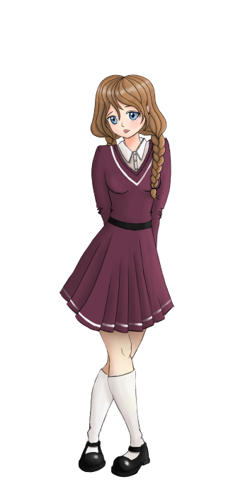
English with
Ionna
and
Natalie
Sam

Slide 2
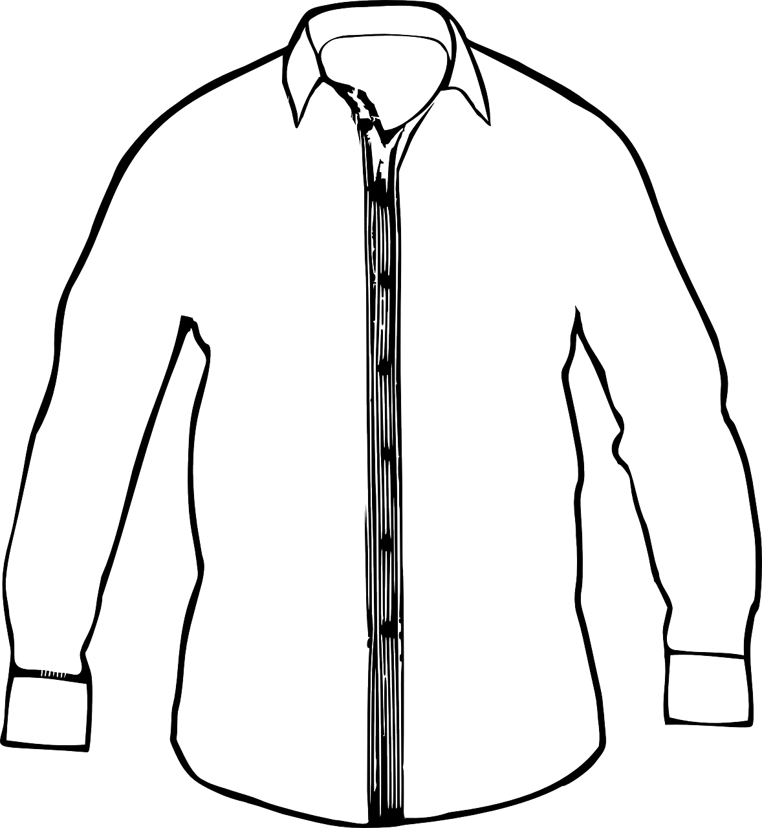
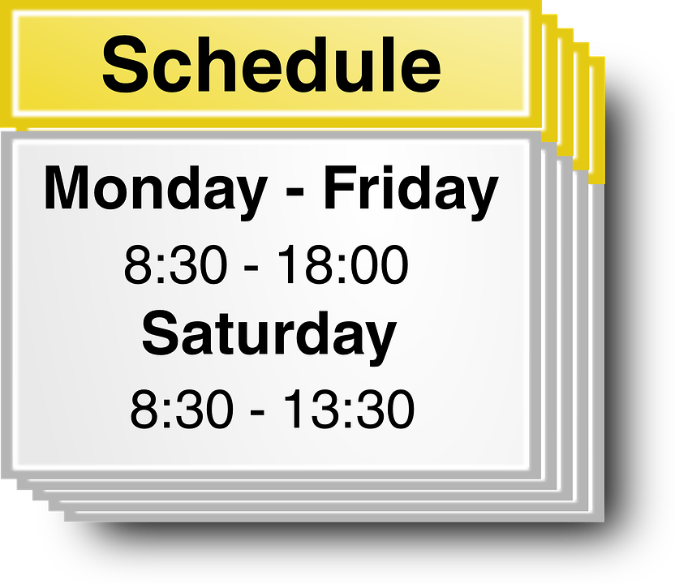
Dans ce cours tu vas
Chanter
Parler de ta journée d’école
Décrire l’uniforme d’un écolier
Dire les jours, les heures et les matières de ton emploi du temps

Slide 3
_{Hello Song}
Let’s sing!
Notes:
Écouter et chanter la Hello Song par dessus

Slide 4
Hello
Sam!
Ionna
Natalie
Notes:
Natalie: Hello, what’s your name?
Sam enregistré : Hello, my name’s Sam! Nice to meet you!
Sam : Who are you?
Natalie : Hello, I’m Natalie
Ionna : Hello my name’s ionna, nice to meet you too!

Slide 5
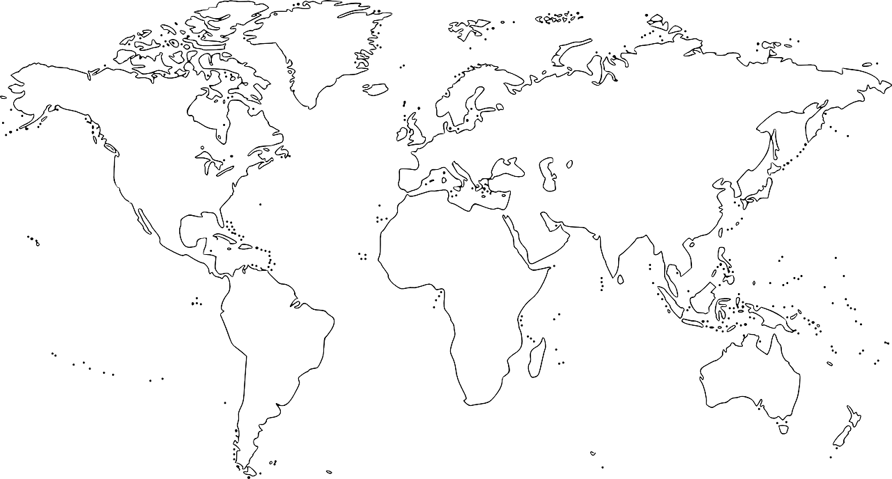
Australia
United Kingdom
Australia
Notes:
Sam dit où elle habite
Puis elle dit qu’elle va aller voir sa copine en Australie
“let’s go to Australia ”

Slide 6
Hello
AUSTRALIA
Olivia!
Notes:
Hello Sam - my Name’s Olivia – I come from Australia.

Slide 7
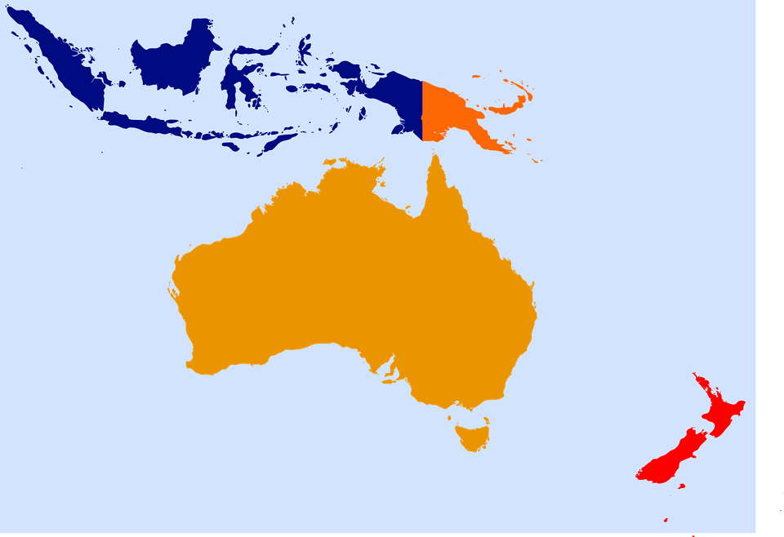
Australia
Notes:
This is Australia, it’s a very big island.

Slide 8
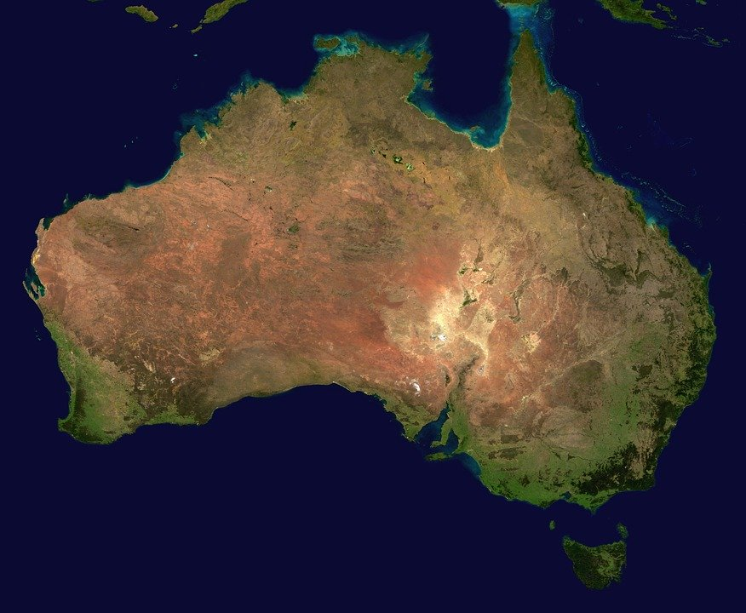
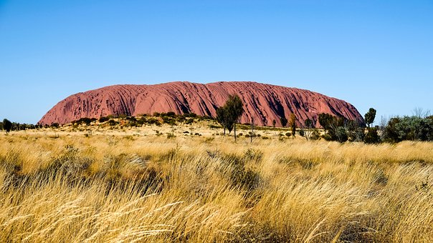
Australia
Notes:
There is a big desert in the middle

Slide 9
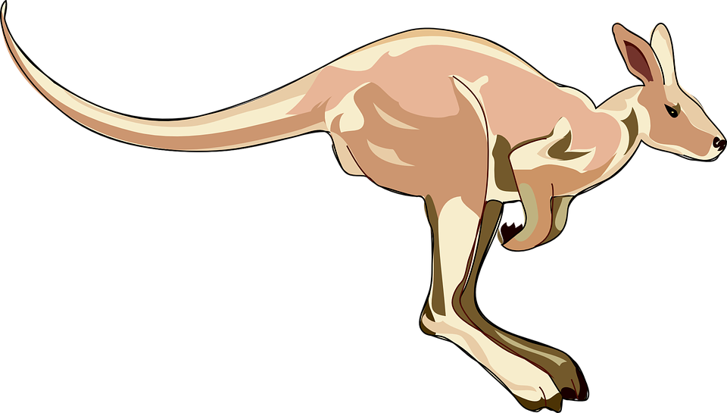
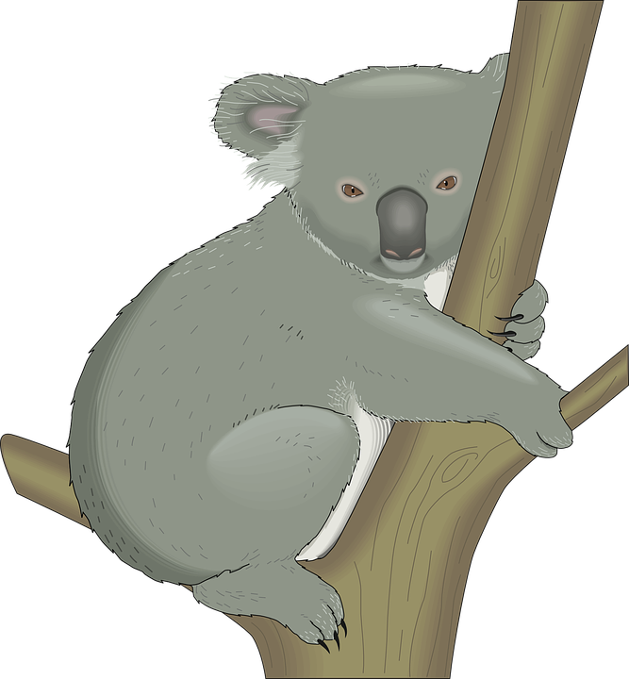
Australia
Notes:
There are wild animals - There are kangaroos, koalas and penguins!

Slide 10
Sydney
Sydney
Notes:
Sydney is a big city in Australia

Slide 11
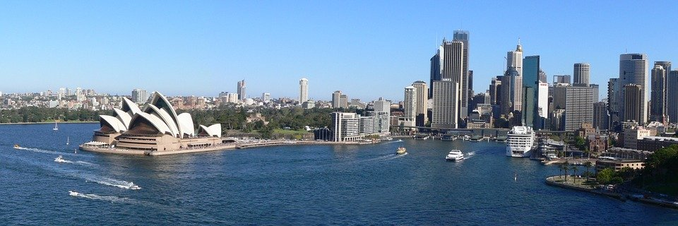
Sydney
Notes:
This is Sydney

Slide 12
Australia
Canberra
Melbourne
Victoria
Sydney
Notes:
Natalie/ Ionna
Where do you live Olivia ?
Face camera
I live… in Sydney
Very good!

Slide 13
School day
Notes:
Un truc comme : Let’s go to school together
Natalie : Let’s go to school!
Ionna : Let’s get ready for the day to school OU Follow me at a day at school Je propose Let’s get ready simplement

Slide 14
School day
Let’s sing!
Notes:
Let’s sing!

Slide 15
Now sing!
This is the way we go to school, go to school, go to school. So early in the morning.
Notes:
??????

Slide 16
School day
Days | Activity
Monday | School
Tuesday | School
Wednesday | School
Thursday | School
Friday | School
Saturday | Weekend
Sunday | Weekend
Notes:
Dire et faire répéter Days of the week (Monday….
On Monday it’s school day
On Saturday it’s day off there is no school

Slide 17
School day
Monday Tuesday Wednesday
Thursday Friday
Saturday Sunday

Slide 18
School day
TUESDAY
WEDNESDAY
THURSDAY

Slide 19
School day
SATURDAY
SUNDAY
MONDAY

Slide 20
Find the missing days!
MONDAY
?
TUESDAY
WEDNESDAY
?
THURSDAY
?
?
FRIDAY
SATURDAY
SUNDAY
?

Slide 21
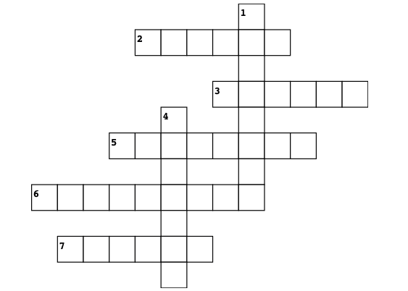
CROSSWORDS
Across
2. Lundi
3. Dimanche
5. Jeudi
6. Mercredi
7. Vendredi
Down
Samedi
4. Mardi
S
T
R
A
MONDAY
SUNDAY
T
E
D
Y
THURSDAY
WEDNESDAY
FRIDAY

Slide 22
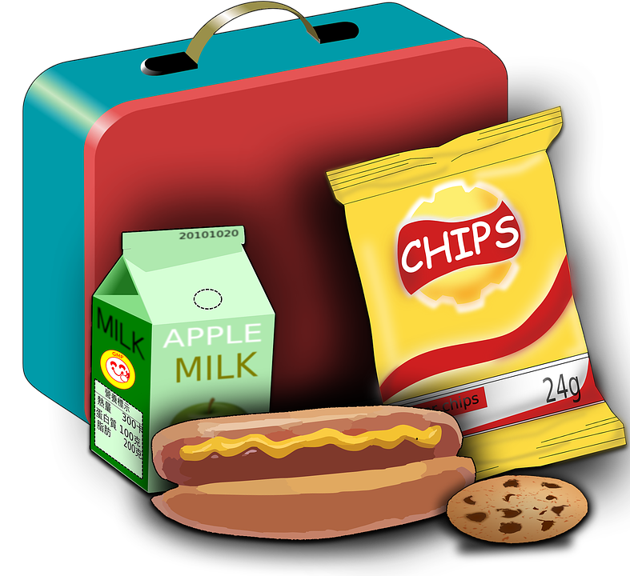
My timetable
Year 3
Time | Monday | Tuesday | Wednesday | Thursday | Friday
9:00 | Maths | History | English | Drama | Science
10:00 | English | French | Art | Maths | Games
12:30 | Lunch
2:00 | Music | Geography | Maths | French | PE
Notes:
Présenter l’emploi du temps d’Olivia
Lire et faire répéter les matières les matières seront à expliciter….propositions de dessins
Notes zoom : year 4 (parenthèse français – year 4 CE2 Australie)
Les horaires en australie sont légèrement différent – ils finissent plus tôt mais regarde ils ont cours le mercredi – c’est le cas dans la plupart des pays anglophones
This is my timetable : dire les jours – répéter les subjects –

Slide 23
My timetable
Year 3
Time | Monday | Tuesday | Wednesday | Thursday | Friday
9:00 | Maths | History | English | Drama | Science
10:00 | English | French | Art | Maths | Games
12:30 | Lunch
2:00 | Music | Geography | Maths | French | PE
Notes:
What’s your favourite subject Olivia?
My favourite subject is Maths!
Faire apparaître maths

Slide 24
My timetable
Year 3
Time | Monday | Tuesday | Wednesday | Thursday | Friday
9:00 | Maths | History | English | Drama | Science
10:00 | English | French | Art | Maths | Games
12:30 | Lunch
2:00 | Music | Geography | Maths | French | PE
Notes:
What’s your favourite subject Sam ?
My favourite subject is English

Slide 25
My timetable
Year 3
Time | Monday | Tuesday | Wednesday | Thursday | Friday
9:00 | Maths | History | English | Drama | Science
10:00 | English | French | Art | Maths | Games
12:30 | Lunch
2:00 | Music | Geography | Maths | French | PE
Notes:
What about you, what’s your favourite subject ?
My favourite subject is …

Slide 26
My timetable
?
Time | Monday | Tuesday | Wednesday | Thursday | Friday
9:00 | Maths | History | English | Drama | Science
10:00 | English | French | Art | Maths | Games
12:30 | Lunch
2:00 | Music | Geography | Maths | French | PE
Music
Notes:
1 de nous peut dire I love Music…toi la chanteuse ;-) pour une transition
When do you have Music Olivia ?
I have Music on Tuesdays at 2!
(on répond nous)

Slide 27
My timetable
Mondays
Tuesdays…
on
I have
Music
at
Notes:
I have art at …7 on …Mondays

Slide 28
My timetable
?
Time | Monday | Tuesday | Wednesday | Thursday | Friday
9:00 | Maths | History | English | Drama | Science
10:00 | English | French | Art | Maths | Games
12:30 | Lunch
2:00 | Music | Geography | Maths | French | PE
English
English
Notes:
Now it’s your turn
When do you have English ?
I have English on Mondays at 10 and on Wednesdays at 9 !

Slide 29
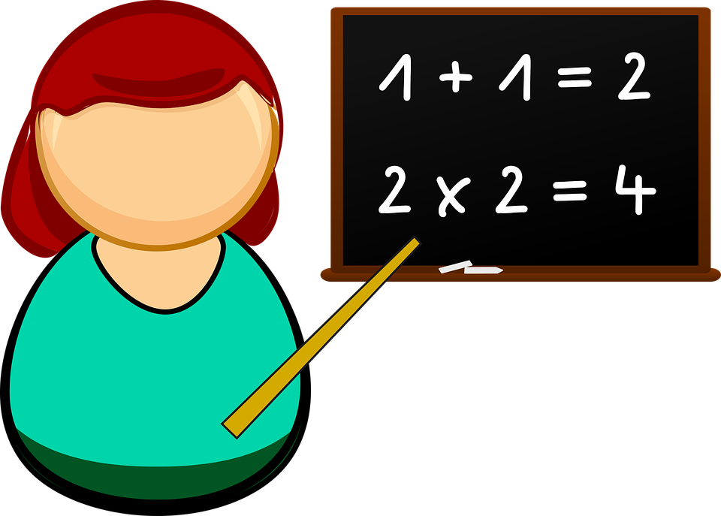
My timetable
?
Time | Monday | Tuesday | Wednesday | Thursday | Friday
9:00 | Maths | History | English | Drama | Science
10:00 | English | French | Art | Maths | Games
12:30 | Lunch
2:00 | Music | Geography | Maths | French | PE
Maths
Maths
Notes:
A la camera
When do you have Math?
I have Math on on Mondays at 9 am on Wednesday at 2.

Slide 30
Memory game 1! Concentrate!!!
Time | Monday
9:00 | Maths
10:00 | English
12:30 | Lunch
2:00 | Music
Notes:
What time do you have Lunch?
I have lunch at 12:30
What time do you have music? I have music at 2.
What time do you have English

Slide 31
Good memory?
Time | Monday
9:00
 | English
 | Lunch
2:00
Maths
10:00
12:30
Music
Notes:
What time do you have Lunch?
I have lunch at 12:30
What time do you have music? I have music at 2.
Proposition de slide pour la restitution des réponses à voir avec animations
What time do you have English

Slide 32
Memory game 2! Concentrate!!!
Time | Monday
 | Science
10:00
 | Lunch
2:00
9:00
Drama
12:30
PE
Notes:
What time do you have Lunch?
I have lunch at 12:30
What time do you have music? I have music at 2.
What time do you have English

Slide 33
Ready?
Time | Monday
9:00
Science
10:00
Drama
12:30
Lunch
2:00
PE
Notes:
What time do you have Lunch?
I have lunch at 12:30
What time do you have music? I have music at 2.
What time do you have English

Slide 34
Notes:
I have maths at 9..
But what do you do at 7 Olivia?

Slide 35
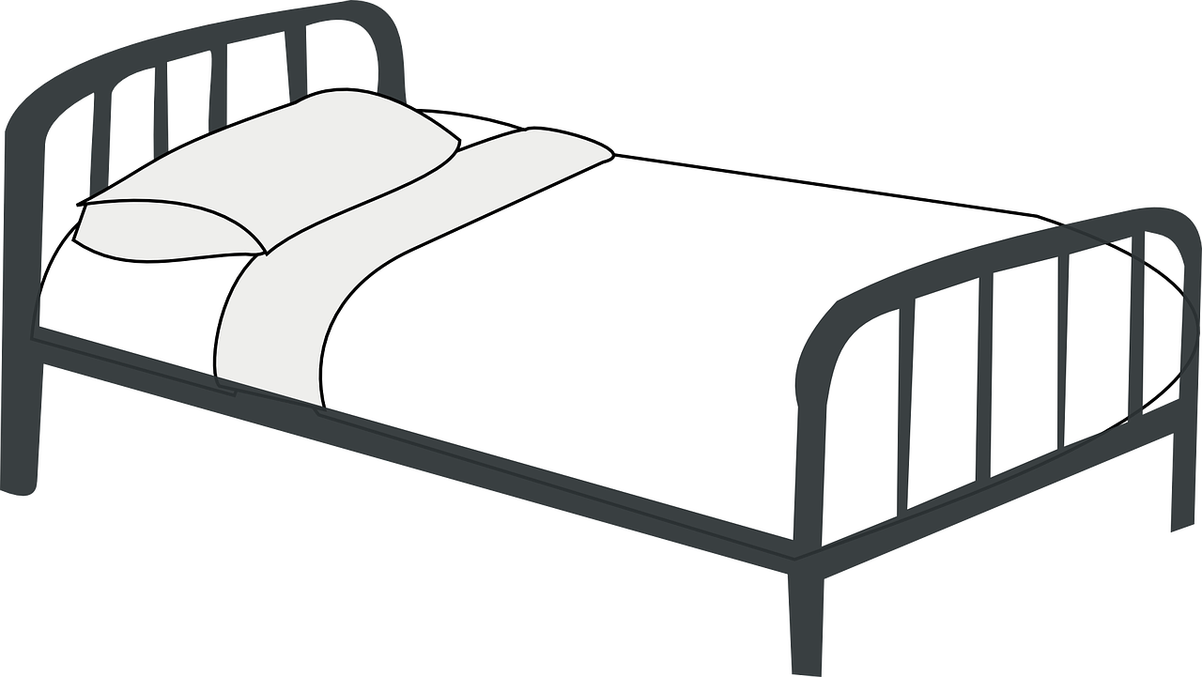
School day
7:00 AM
Notes:
I get up at 7am

Slide 36
School day
7:30 AM
Notes:
I have breakfast at 7:30

Slide 37
School day
8:30 AM
Notes:
I go to school at 8:30

Slide 38
School day
9:00 AM
Notes:
I start school at 9 AM

Slide 39
Let’s recap
7:00 AM
7:30 AM
8:30 AM
9:00 AM
Notes:
At 12:30 I… - garder les 2 colonnes

Slide 40
School day
12:30 PM
Notes:
I have lunch at 12:30

Slide 41
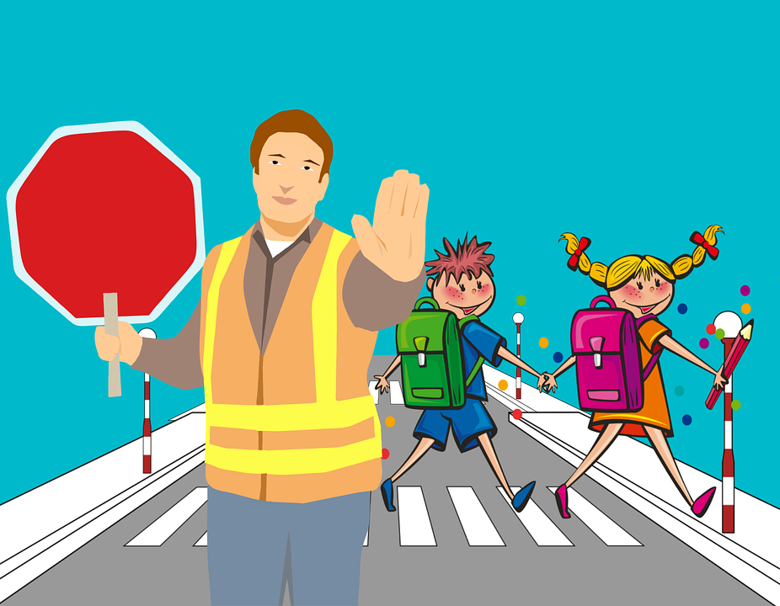
School day
4:00 PM
Notes:
I finish school at 4

Slide 42
School day
4:30 PM
Notes:
I play at 4:30 pm

Slide 43
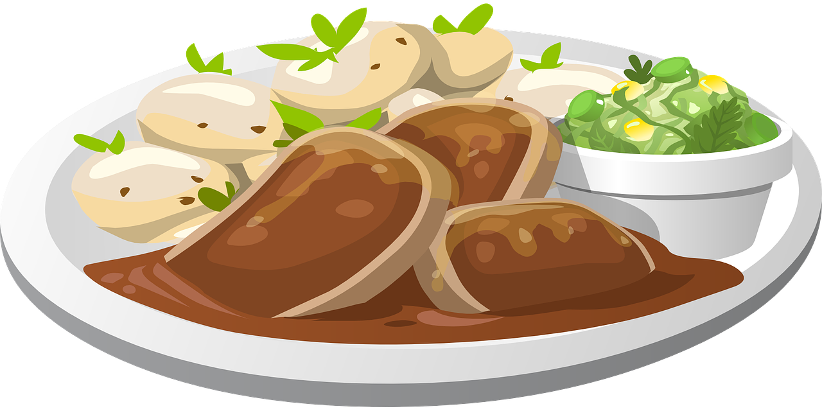
School day
7:00 PM
Notes:
I have dinner at 7:00 pm

Slide 44
School day
8:00 PM
Notes:
I go to bed at 8:00 Pm

Slide 45
Let’s recap
12:30 PM
4:00PM
4:30 PM
7:00 PM
8:00 PM
Notes:
AM - morngin

Slide 46
Let’s recap
7:00 AM
7:30 AM
8:30 AM
9:00 AM
Notes:
At 12:30 I… - garder les 2 colonnes

Slide 47
Let’s recap
12:30 PM
4:00 PM
4:30 PM
7:00 PM
8:00 PM
Notes:
AM - morngin

Slide 48
Challenge 1
Notes:
-audio et entourer la bonne image sur les 3 proposées

Slide 49
Challenge 2
Notes:
entourer la bonne image sur les 3 proposées

Slide 50
Challenge 3
Notes:
listen and find the actions
I start school
I finish school

Slide 51
School day
Notes:
What time do you get up?

Slide 52
School day
Notes:
What time do you have lunch ?

Slide 53
Notes:
Recap Listen and repeat :
– remettre toutes les actions et on répète

Slide 54
A black cat in my backpack
Tongue twister

Slide 55
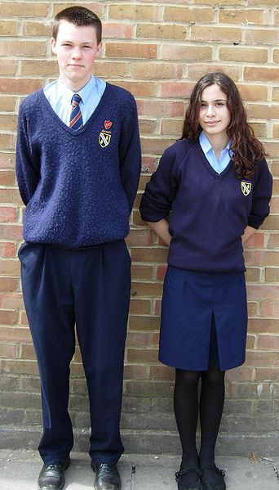
Uniform
Uniform!
Notes:
Ok audio Olivia : In Australia we have a uniform! – look at my school uniform !
Sam : In England, we have a uniform too
Slide d’après : On porte des uniformes en Inde, Afrique du Sud, Ireland
I wear a uniform in Ireland…

Slide 56
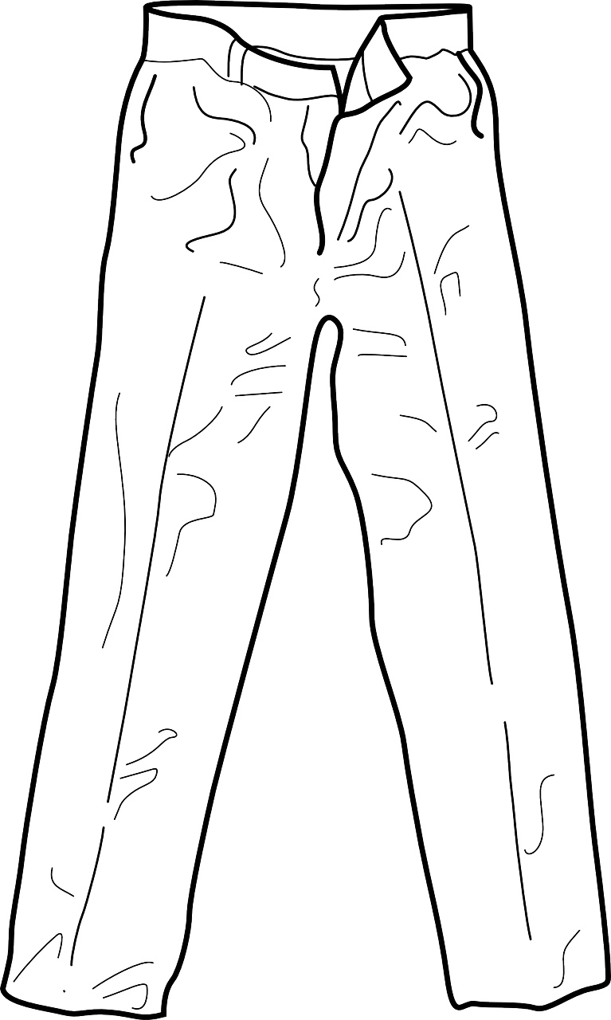
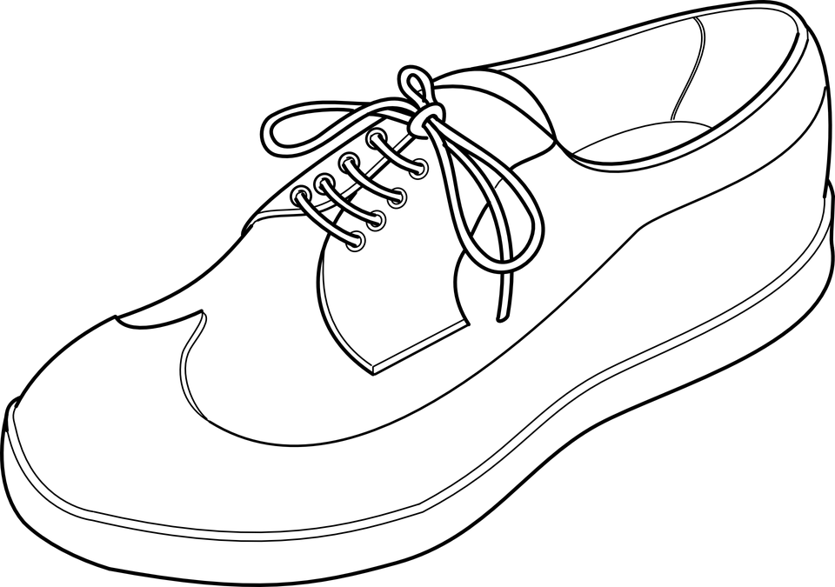
Uniform
Notes:
Uniform for boys
Boys have blue pans
A blue pullover
A light blue shirt
Black shoes
And a tie

Slide 57
Uniform
Notes:
Filles on fait répéter

Slide 58
Let’s recap
Notes:
Slide recap

Slide 59
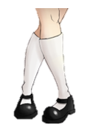
Sam’s uniform!
Notes:
Sam intervient ici : I have a uniform too in the UK
So do you remember my uniform ?
In my school I have a white shirt
A purple pullover
A purple skirt
And black shoes

Slide 60
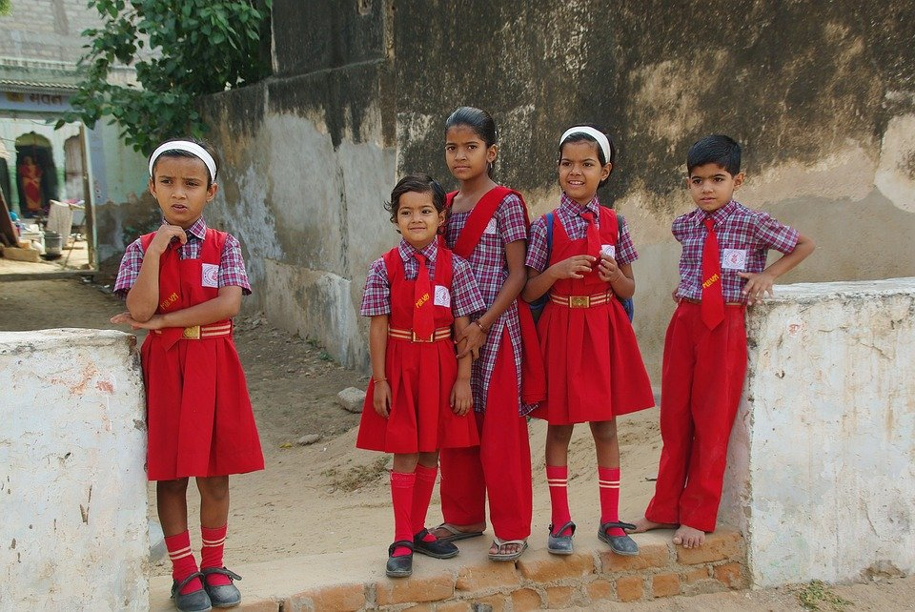
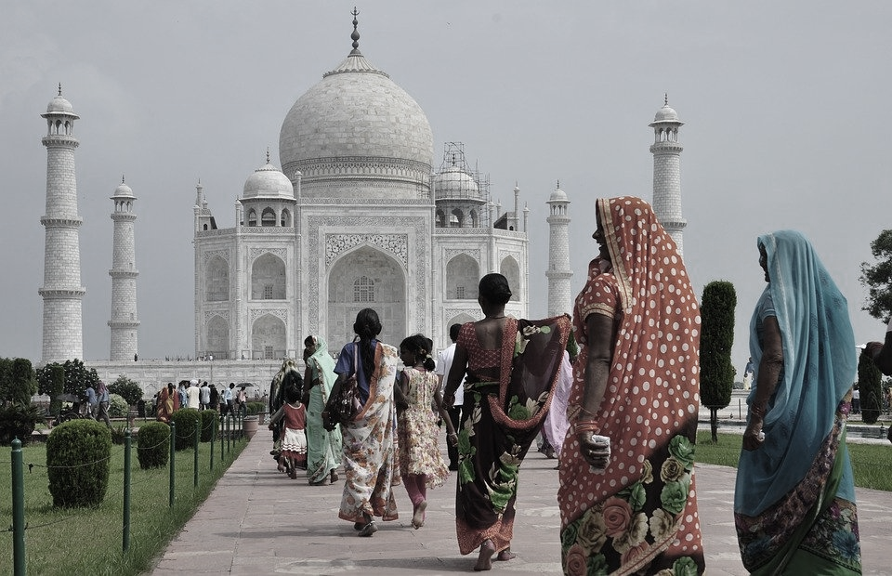
Notes:
Neela participe : we have a uniform in India too!
Natalie ou Ionna : It’s nice! It’s red, Red is my favourite colour! Look!
SI pb couleur photo Inde

Slide 61
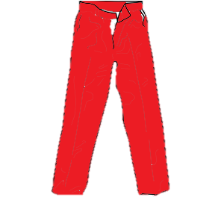
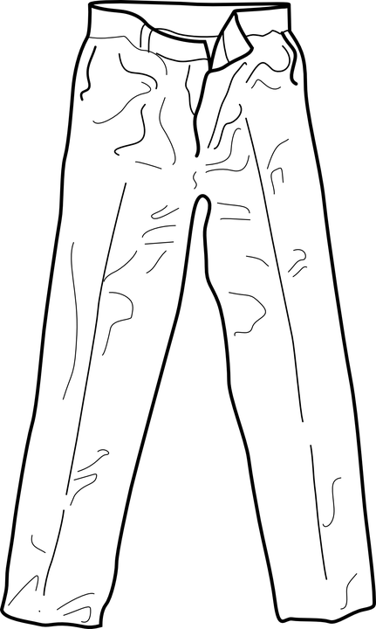
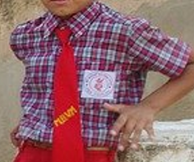
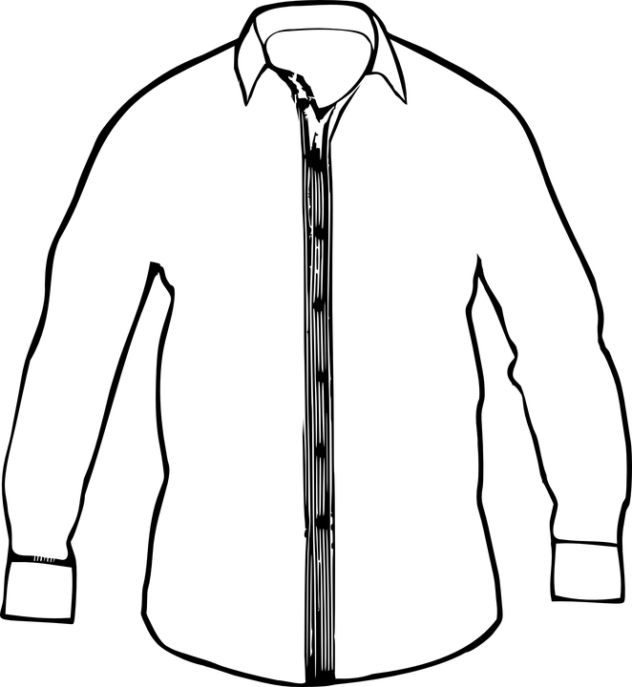
Memory Game
Boys have
Girls have
Boys and girls have
Notes:
Boys have red pants / blue and purple shirt / red tie / black shoe
Girls have… red skirts, bleu

Slide 62
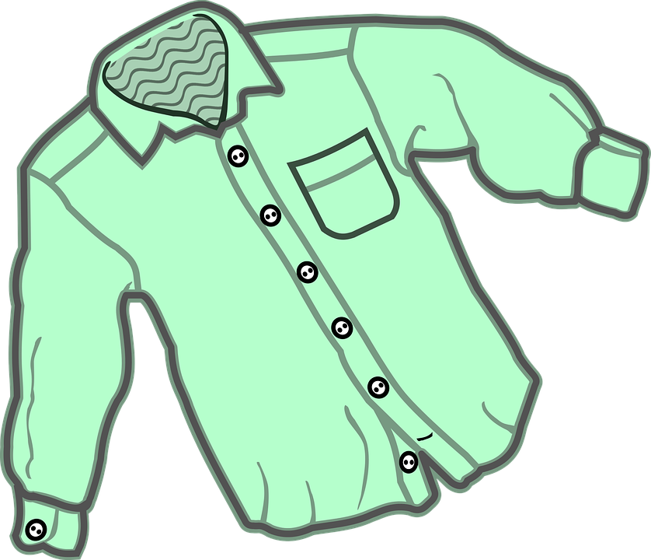
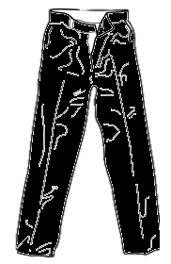
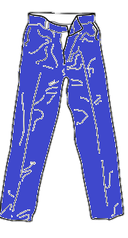
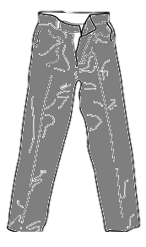
Notes:
Listen to Harry !
Harry intervient : In south africa we have a uniform too..
In my school boys have an grey shirt, blue pans, a black tie and black shoes

Slide 63
Uniform
Notes:
In France we don’t have a uniform

Slide 64
Challenge
3
2
1
6
4
5
Notes:
What’s number 1 / 2 / 3
What number is the tie?
What number is the skirt?

Slide 65
Dans ce cours tu as appris
Décrire un uniforme
Donner les jours et les heures
Parler de ta journée d’école
Time | Monday
9:00 | Maths
10:00 | English
12:30 | Lunch
2:00 | Music
Donner ton emploi du temps d’élève

Slide 66
_{Goodbye Song}
Let’s sing!
Notes:
Écouter et chanter la Hello Song par dessus

