Slide 1
Our
34 %
My English/ Maths Class
2 : 5
a
b

Slide 2
Objectifs
Dans ce cours on va:
découvrir comment on consomme et quels sont les facteurs qui nous influencent dans nos choix
parler, comprendre en anglais
apprendre à analyser des indications chiffrées et les graphiques
utiliser les mathématiques : raisonnement et vocabulaire.

Slide 3
Recommandations
Parler en anglais
Participer activement
Recopier les parties indiquées COPY
Retrouver le cours et l’émission en Replay sur le site Lumni de France 4

Slide 5
How do I choose...?

Slide 6
It depends on the...
Price
Brand
It’s a guarantee of quality
Quality
Opinion
Style
Trend
Notes:
@ Cyril tu dis les termes Price/ Quality/ Style / Brand …. et après “Trend” tu peux poser la question
‘ Why do we decide to buy ? ‘

Slide 7
Why do you decide to buy ?

Slide 8
You usually buy a product ...
for its convenience
for its replacement
for its prestige
for its price / good value
for its quality
for its emotional value
Notes:
@ Cyril: Tu pourras répéter CONVENIENCE/ REPLACEMENT/ PRESTIGE et
je ferai la transition avec la slide suivante et je dirai quelques mots pour présenter le document.

Slide 9
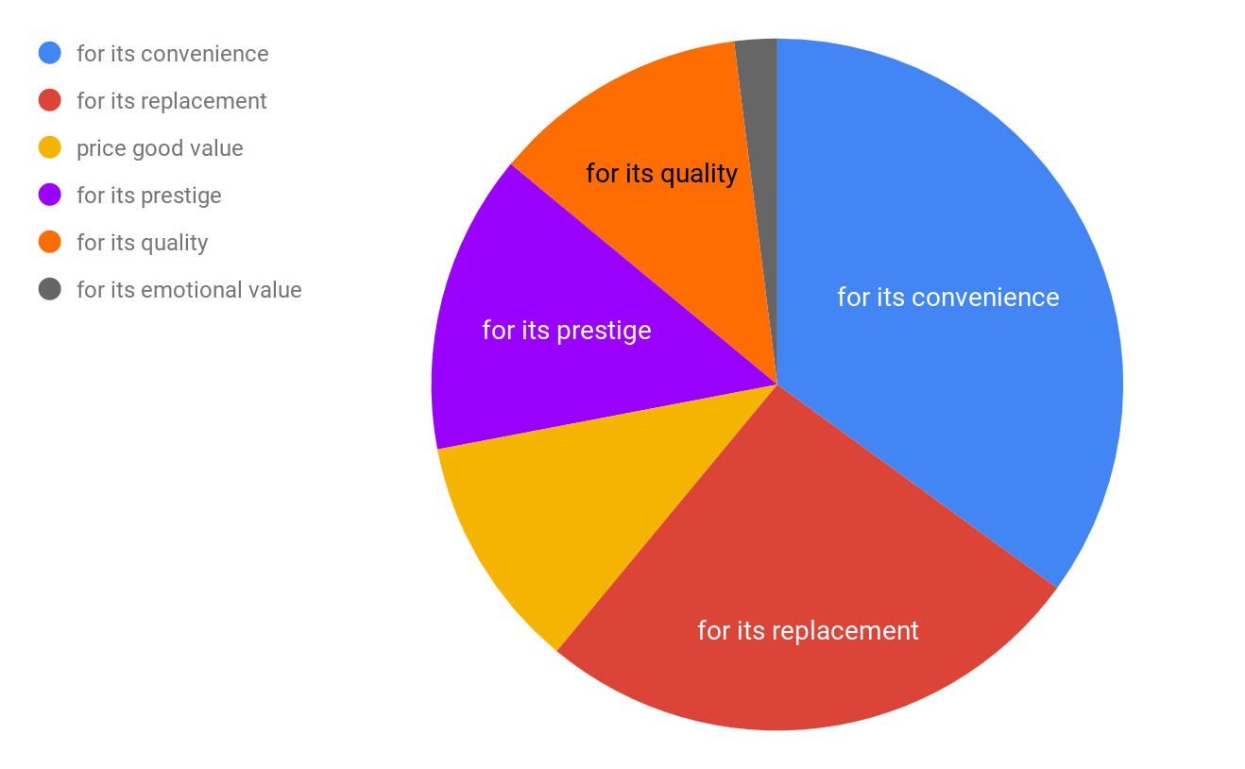
Pie Chart - why do we buy a product ?
Notes:
quasiment autant de convenience que replacement = achat “utile”
A eux 2 plus de la moitié donc plus de 50 %, pourcentage qui détermine plus de la moitié
prestige et qualité plus d’un quart angle de 90°
Quasiment autant de emotionnal, prestige et quailty.
Compare des proportions et pas les valeurs. les uns regroupés par rapport aux autres et les uns par rapport au tout.

Slide 10
How to analyse a pie chart ?
Vocabulary
a pie chart
a section
the data
a percentage
a proportion
Most of the customers buy a product for its convenience or its replacement.
Some (+1/4) buy for its quality or prestige.
Few (less than 1/4) customers buy for its emotional value.
Notes:
corriger ici
plus de la moitié dire que c’est 50%
¼ = 25%
@ Cyril pour la transition tu pourras poser la question ‘ So you said that prices influenced our choices can you explain how?

Slide 11
How do prices influence our choices ?

Slide 12
Let’s compare ...
The pink t-shirt is cheaper than the blue t-shirt. You prefer the blue one but it’s too expensive !
$20
Decoy
$80
$100
The yellow t-shirt is the most expensive but it makes the blue t-shirt more reasonable. So, you think” £80 is not too bad."
Is it really a ‘good’ bargain ?
Notes:
@ Cyril tu diras ‘it’s too expensive ‘ it’s not too bad ‘ et ‘ I would choose the blue one ‘ ‘ Is it really a good bargain? ‘

Slide 13
$125
$ 150
$59
32 %
68%
+
More people subscribed the digital offer than the print offer.
Customers prefer subscribing the combo offer to the digital offer.
84%
$12 600
Notes:
@ cyril : Yes but sometimes we need both versions

Slide 14
The decoy effect
The decoy effect is often used in subscriptions. It encourages you to buy more.
In this experiment there were three options : digital version ($59), print version ($125) which was the decoy option and the combo version where customers got both digital and print versions for ($150). There were 2 cases.
In the first case with 2 options : the print-only and the digital version. 68% of customers bought the digital version, and 32% bought print only version.
In the 2nd case with 3 options : 84% of customers purchased the combo version generating a total revenue of $ 12 600. The customers preferred subscribing the combo version because they believed it was a good bargain.
Notes:
@ Cyril : je vais lire le texte et après je te poserai 4 questions :
How many options were there ? there were 3 options ( the print version/ the digital / the combo version)
Which option was the most expensive ? the combo version
Which option was the cheapest? the digital version
Which option did most of the customers purchase? the combo version .
What is the decoy effect ? ‘ it’s like an attraction effect ‘ et je vais l’écrire et après je dirai ‘ another synonyme is ‘ lure ‘ et je te le ferai répéter.
So could you tell us the total revenue it generated for the company? Is it a question of proportion?

Slide 15
How to calculate with a proportion?
TOTAL REVENUE (all options included)
Revenue of the combo version
+
84%
$12 600
Notes:
présence du point et de la virgule
réponse 15 000
@Cyril après ta démonstration je ferai la transition sur les brands.

Slide 16
How do brands influence our choices ?

Slide 17
Teenager opinions on brands
I agree with Terry.
Terry, “ I believe brands create a connection between the consumer and the product. “
I totally disagree with Jane because sometimes there are fake promises.
Jane “ Brands are like loyal friends they never disappoint you!”
I partly share Kate’s opinion because you don’t have to buy a product because of the brand.
Kate “ I hate brands as you become a consumer slave ! No thanks!”
What’s your opinion?
Notes:
Je te ferai donc interagir sur les bulles pour que tu puisses dire les expressions.

Slide 18
Sharing opinions
I believe …
In my opinion..
According to ...
I agree with …
I share ….’s opinion
I absolutely agree
I partly agree
I’m not sure about that
I don’t agree with…
I totally disagree
That’s not true.

Slide 19
How can other people's opinions influence our choices ?

Slide 20
Opinion leaders
They are people who give their opinion. They are influencers or trend setters because they can be very influential on your consumer decisions.
$80
only
Opinion (10)
“It’s good value for money even if it is basic. You should buy it.”
Companies get the influencers to promote their products and services.
3/ 5
They get you to buy a product .
Notes:
@Cyril : Ici tu poseras la question ‘what’s an opinion leader? “

Slide 21
Grammar practice
A trend setter gets you to buy a product.
On implique un effort de persuasion
An opinion leader makes you choose a service.
On implique un lien de cause à effet voire une contrainte
Les structures causatives permettent d’exprimer un lien de cause à effet, de contrainte ou de persuasion.
Notes:
@ Cyril : je te demanderai d’interagir et de changer les phrases en remplaçant les structures dans les phrases.

Slide 22
How to calculate a satisfaction rate?
Opinion
I noticed that when 5 people said that they loved this product, 2 of them don’t mind and 3 of them regret what they bought.
Notes:
@sandrine explique que l’on a des avis mais pas de note
5:2:3
Pas content : 3/10 puis sans avis = 2 pour 10 donc pour les contents 5/10.
soit avis positif = 7/10 donc 3,5 / 5
So now Sandrine, let’s see if you have understood

Slide 23
How to calculate a satisfaction rate?
Satisfaction ratio
12 : 4 : 4
Opinion
Notes:
Here is another example, can you calculate the satisfaction rate ?
@ sandrine : it’s a ratio 12:4:4
That means when 12 people say “i love this product, 4 say they don’t mind et 4 say they don’t like this product”.
Let’s see together how to calculate the satisfaction rate as we saw with Cyril.
il y a l’équivalent de l’avis de 20 personnes (12+4+4).
Donc pour calculer la proportion des personnes contentes en ajoutant les sans avis donc il y a 16/20 avis positifs soient 8/10 ou ⅘ DONC 4 ETOILES

Slide 24
What is today's trend?

Slide 25
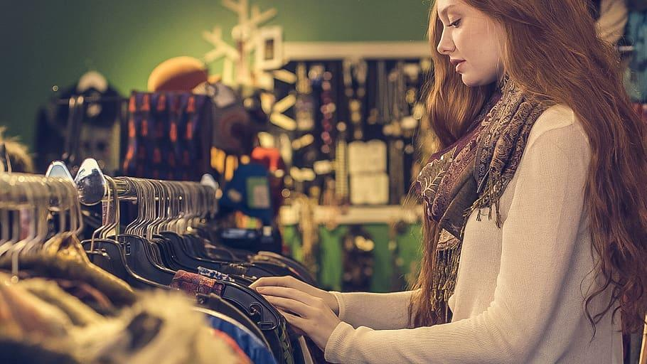
What is the trend today?
Definition
It is the general direction in which something is changing.
Derived words
To be trendy / a trend /
a trend setter
Second hand buying
Notes:
@cyril: Sandrine,what is the definition of trend?
@Sandrine pour transition : let’s see the evolution of this trend depending on the generations.

Slide 26
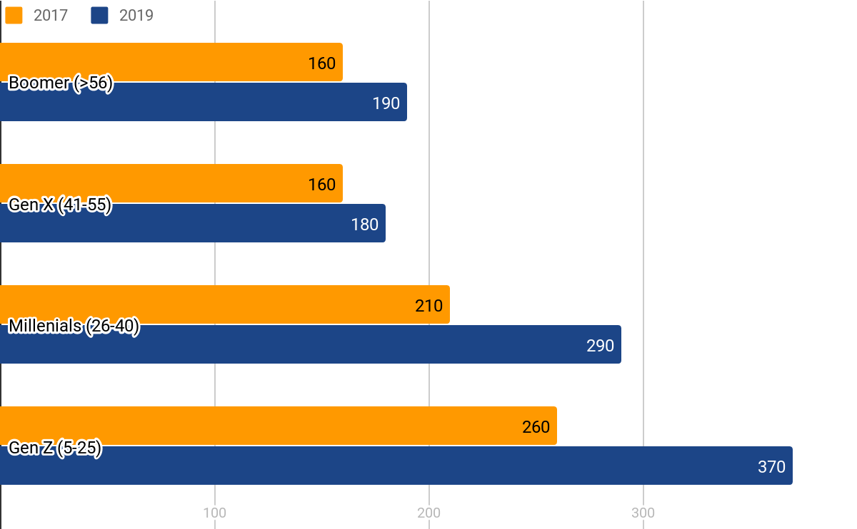
Evolution of second hand buying
Notes:
@Sandrine : showing every generations and yellow is…
transition @sandrine : it seems to have a big difference for the Gen Z between 2017 and 2019, like a quarter more Cyril ??
@Cyril 2 fois plus d’achat pour GenZ que Boomer pour 2019
370 = 260 + 260*aug (360-270 = 110 = écart, la progression).
110 = 260xaug
coeff = 110/260 = 0,42 soit 42% en effet 260 * 1,42 = 370
@Cyril : so Sandrine, can you try to calculate the evolution for the boomers ? (30/160 almost 19% )

Slide 27
What is the impact on our economy ?
The current trend to buy second hand products encourages us :
to buy and think differently.
to spend and produce less.
to reduce waste and maintain economic development
without using our natural resources (= sustainable development).
to educate customers and make them more aware.
Notes:
cyril : sustainable development

Slide 28
Let's advertise our product

Slide 29
What is advertising ?
It is when you pay for space to promote a product, a service or a cause.
It is based on a strategy to make us buy the product.
a target
an opinion
a slogan
Mathematical facts
a price
Media
Notes:
@ Cyril : ici tu peux poser la question ‘What is advertising? ‘

Slide 30
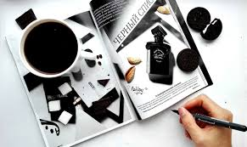
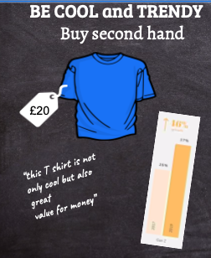
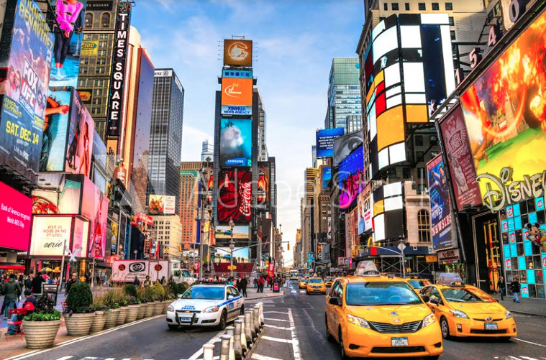
Brand new product for summer
BE COOL and TRENDY
Buy second hand
+42%
$20
“this T shirt is not only cool but also great
value for money”

Slide 31
On récapitule...
COPY
Vocabulary:
an ad/ an advert / an advertisement
a device
a slogan
a brand
a trend
a store/ a shop
to increase/ rise
to decrease / fall
to advertise
to promote
to purchase
Grammar :
deriving words
causative structures:
(make someone do something/ get someone to do something/ persuade someone to do something )
comparatives
Prefer + verb-ing
Would rather ...than
Mathematical terms :
a pie chart
a bar chart
a graph
an axis
a proportion
a ratio
a percentage

Slide 32
Pour aller plus loin
Réaliser une campagne de publicité en incorporant les différentes parties revues dans le cours.
Grammar : https://www.englisch-hilfen.de/en/
Analysing graphs and bar charts in English
https://learnenglishteens.britishcouncil.org/skills/writing/intermediate-b1-writing/describing-bar-chart

Slide 33
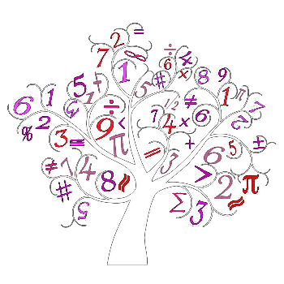
Stay Safe
and
Don’t forget
the protective measures !

Slide 34
Good buy :)

Slide 35
Good bye

Slide 36
Ressources
summer : https://pxhere.com/en/photo/1541433
T-shirts: https://publicdomainvectors.org/fr/gratuitement-des-vecteurs/Rose-t-shirt-vector-images-clipart/11652.html
Trainers: https://pixabay.com/fr/vectors/chaussures-de-sport-formateurs-310941/
newspaper : https://freesvg.org/vector-illustration-of-newspaper-icon
printer : https://pixabay.com/fr/vectors/imprimante-périphériques-matériel-146481/
Pie chart on online consumption
https://lab.getapp.com/research-online-purchase-offline-omnichannel/
secondhandbuying : https://commons.wikimedia.org/wiki/File:Brand_new_second_hand.jpg
secondhand buying charts : https://www.thredup.com/resale?tswc_redir=true
secondbuying woman : https://www.pxfuel.com/en/free-photo-xnctv
Time square https://fr.wikipedia.org/wiki/Fichier:Times_Square_Lightboards_-_USA.jpg
Calculator https://www.publicdomainpictures.net/fr/view-image.php?image=82908&picture=calculatrice-noir-clipart
Definition / phonetics : macmillandictionary.com

