Slide 1
CLIL
CM2 - Year 6
Geography
in English

Slide 2
Hello song

Slide 3
CLIL
CM2 - Year 6
Geography
in English
by Mathilde and Sandrine

Slide 4
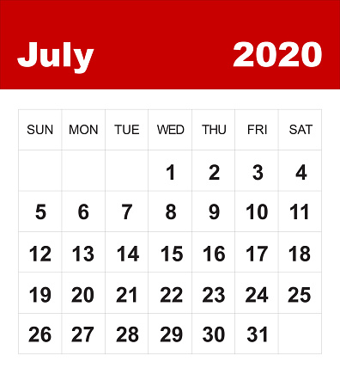
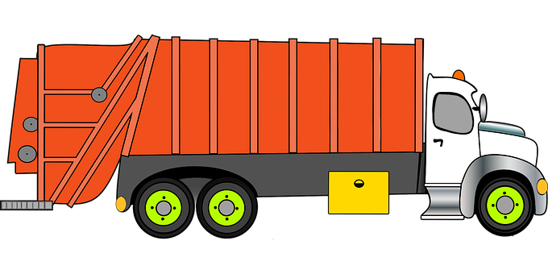
Trash day

Slide 5
Geography in English
Supplies and Orders
3 R
Let’s do it!
Remember
Challenge

Slide 6
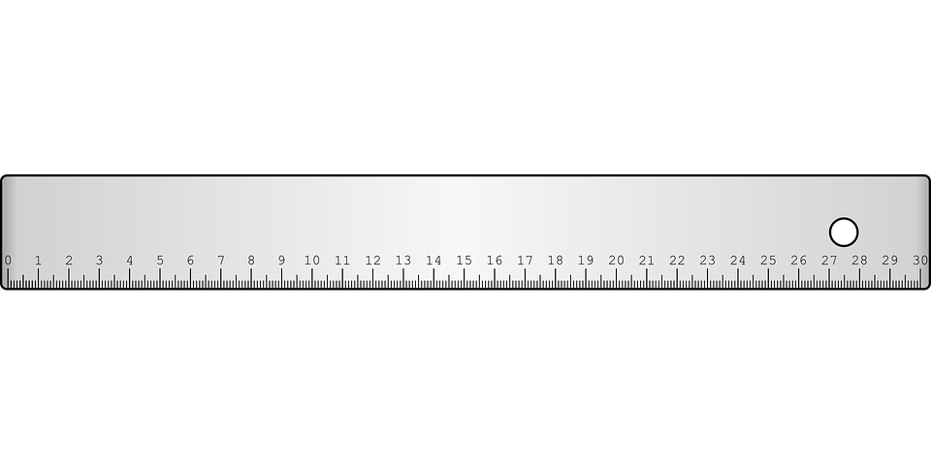
You need ...
a r_l_r
gl__
a p_nc_l
sc_ss_rs

Slide 7
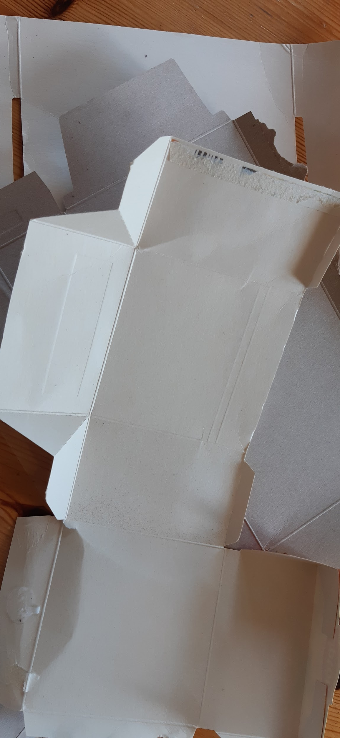
And...
cardboard packaging
plastic caps

Slide 8
Orders
c_t
dr_w
st_ck
m__s_r_

Slide 9
New Order
sort

Slide 10
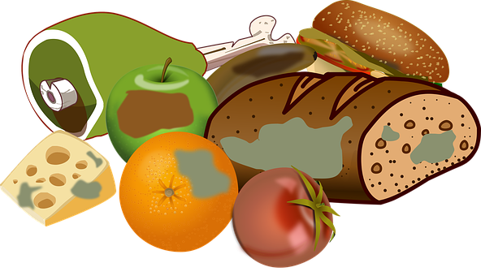
What is waste?

Slide 11
Let’s reduce the waste!

Slide 12
Let’s sort the waste!
glass
food
green
waste
plastic paper
cans

Slide 13
Let’s recycle!
glass
new bottles

Slide 14
Let’s recycle!
green waste
compost

Slide 15
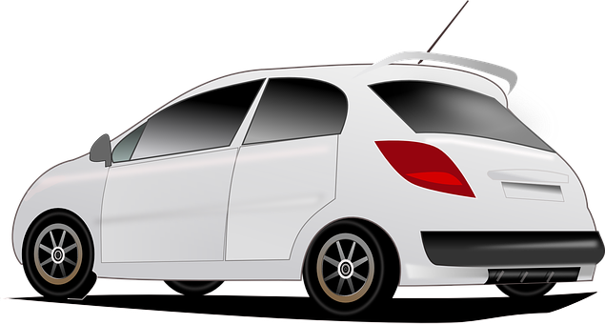
Let’s recycle!
cans

Slide 16
Let’s recycle!
plastic / paper

Slide 17
Can you sort to recycle?

Slide 18
Let’s reuse!
32 cm
32 cm

Slide 19
Let’s measure!
0 cm
4 cm
8 cm
12 cm
.….. cm
…... cm
…… cm
…… cm

Slide 20
The other side…
0 cm
4 cm
8 cm
12 cm
.….. cm
…... cm
…… cm
…… cm

Slide 21
Draw the lines…

Slide 22
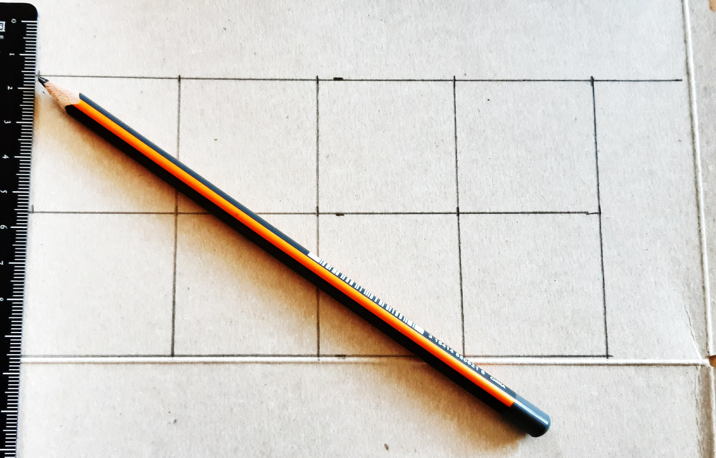
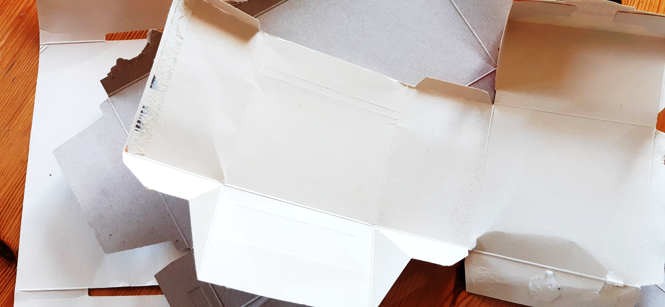
Let’s draw squares!

Slide 23
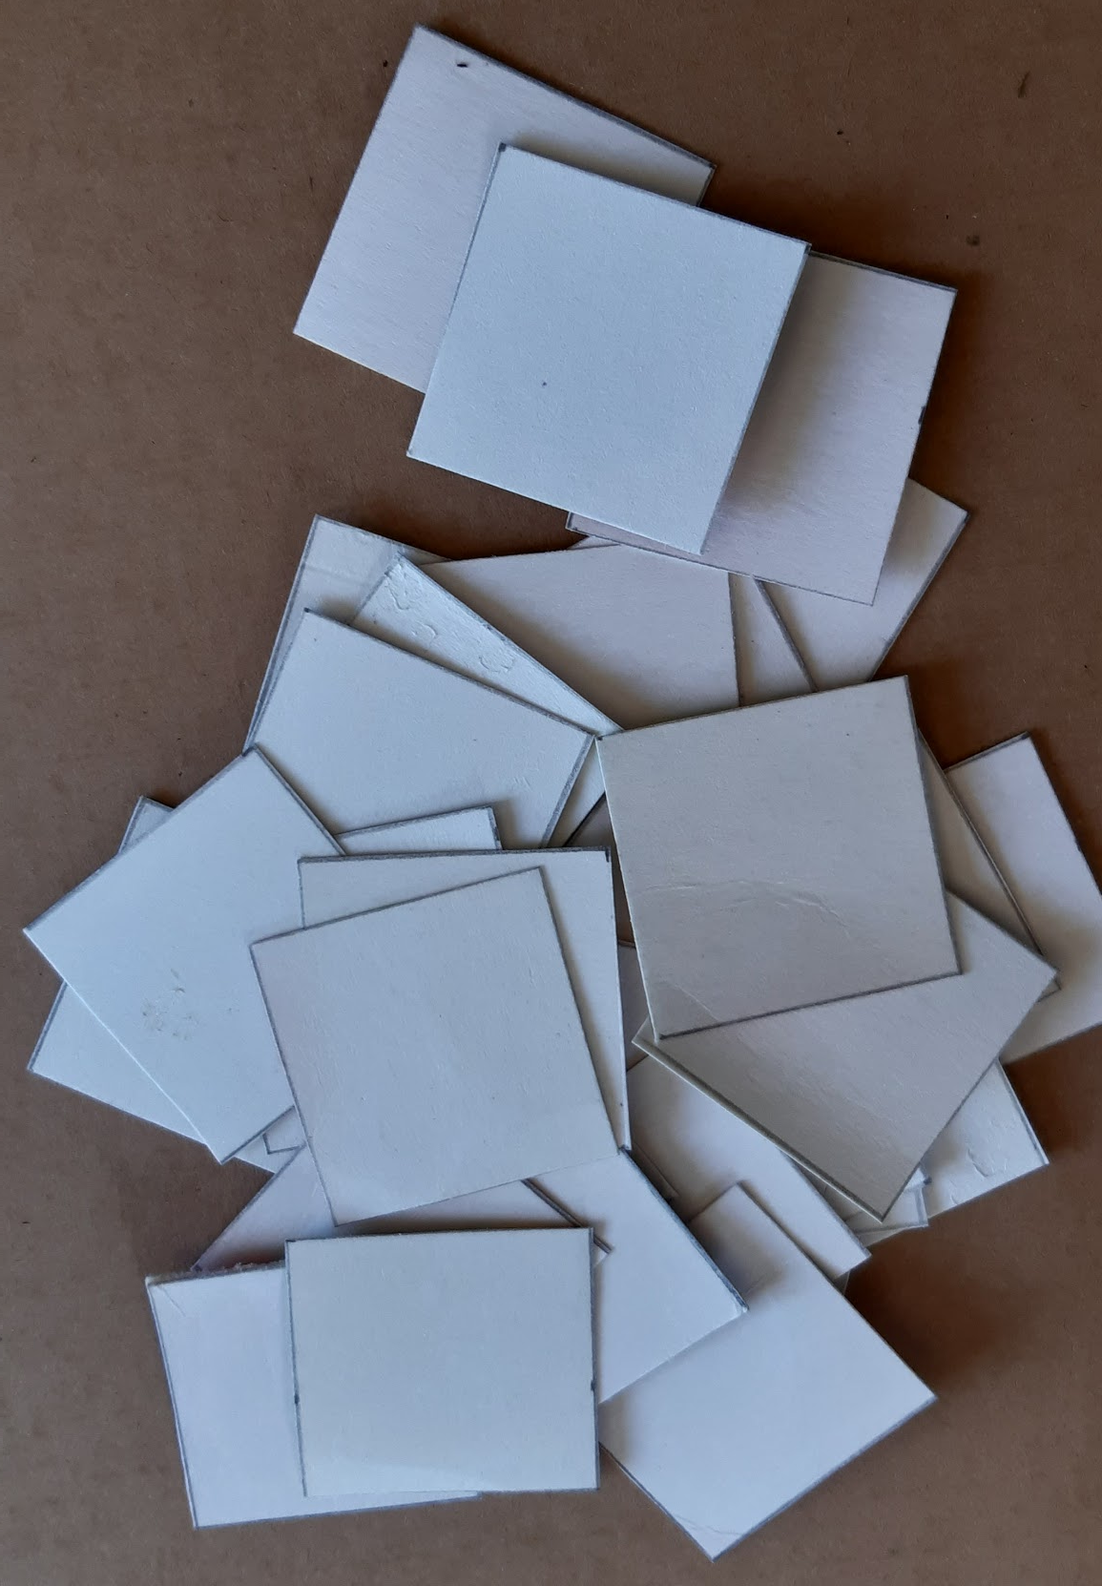
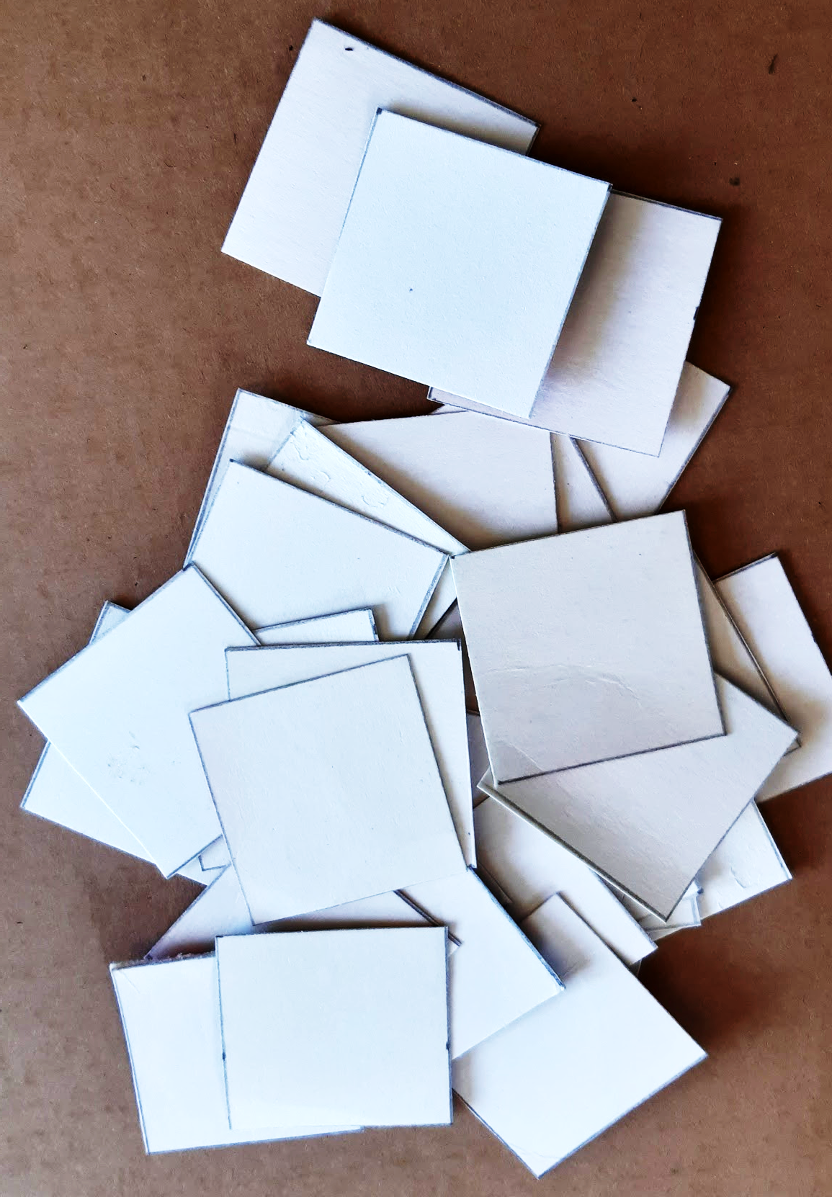
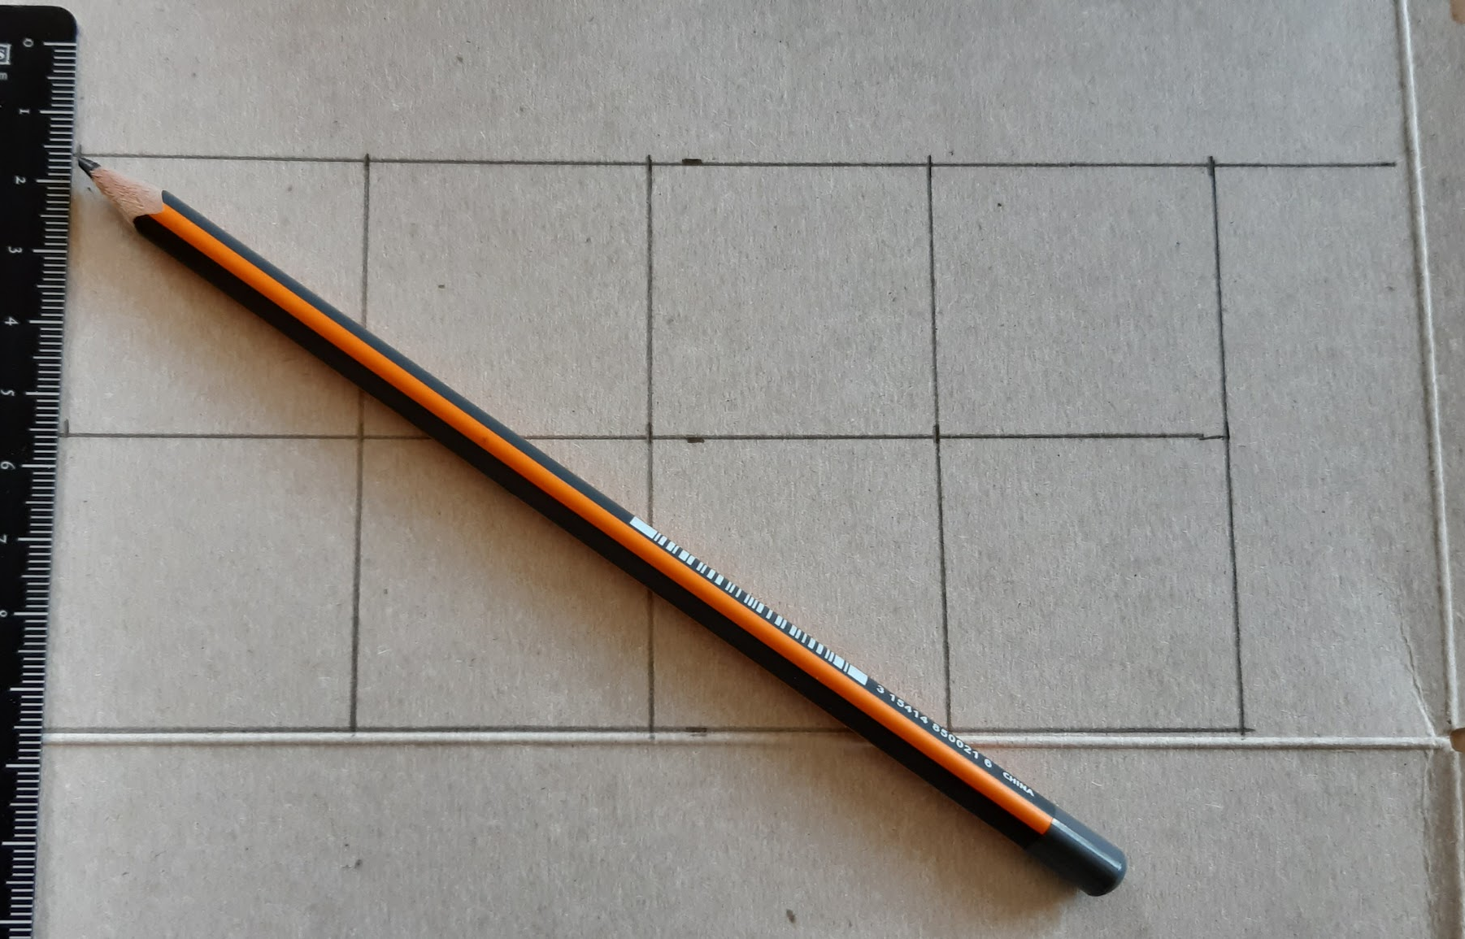
Let’s cut!
32 squares

Slide 24
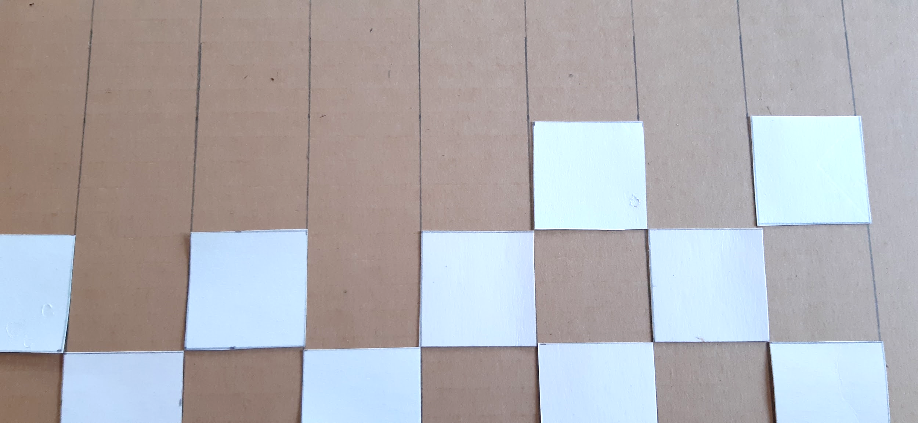
Let’s stick!

Slide 25
A board !
checkered board

Slide 26
Let’s find!
12 caps
2 x 6
3 x 4

Slide 27
Let’s play!
checkers !!!

Slide 28
Let’s recap!
Sort waste
Reduce waste
Recycle waste
Reuse
Recycled «checkered board»

Slide 29
Challenge!
Create another game
Use recycled materials only

Slide 30
Geography in English
3 R
Use waste to create a game
Challenge

Slide 31
Goodbye song

Slide 32
CLIL
CM2 - Year 6
Goodbye
from Mathilde and Sandrine

Slide 33
Ressources and contributions
Pictures
https://stock.adobe.com/ https://pixabay.com/fr/
https://www.flaticon.com/ https://www.clipart.com/fr/index
Personal photos
Characters
Sam Lumni and her friends drawn by Manon
Audio recordings
Voices : Tess, Mansi, Lukas, Immanuel, Emily, Eddie, Sydny, Jacklyn, Richard, Dain, Erin
Music, melody and lyrics by Stephane and François
Conception
Anna, Anne-Valérie, Mathilde, Sabrina et Sandrine

