Slide 1
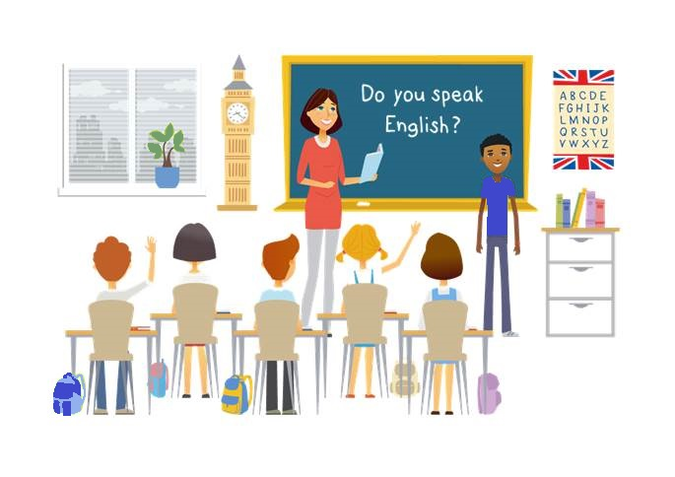
CM2 - Year 6
English
Class

Slide 2
Hello song

Slide 3
CM2 - Year 6
English
Class
by Anne-Valérie and Anna

Slide 4
Today’s lesson
Se déplacer avec un plan
Découvrir des animaux d’Australie
Trier les déchets
Protéger la planète
Ecrire un slogan

Slide 5
You need …
a whiteboard marker
a pencil
a copybook
colour pencils
a whiteboard

Slide 6
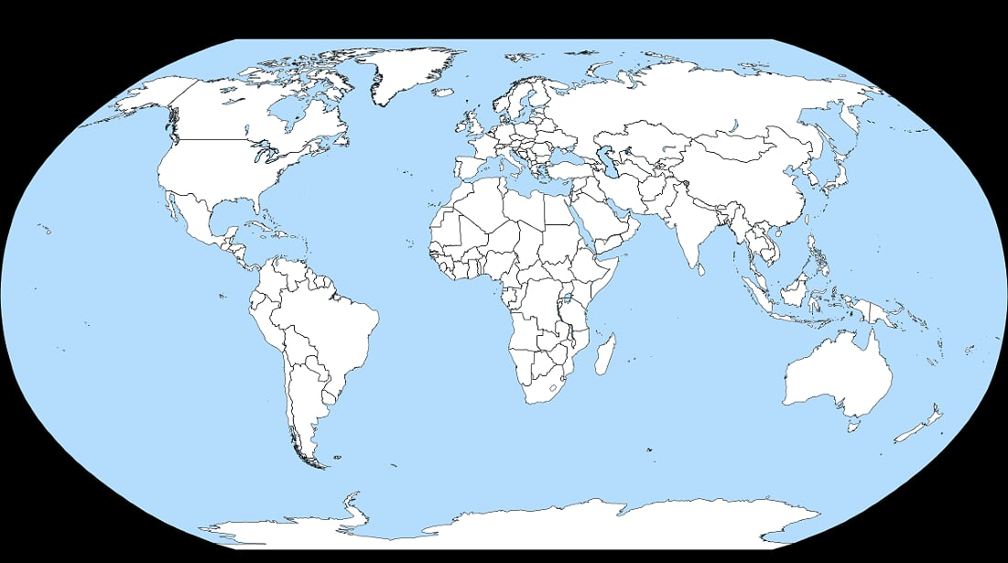
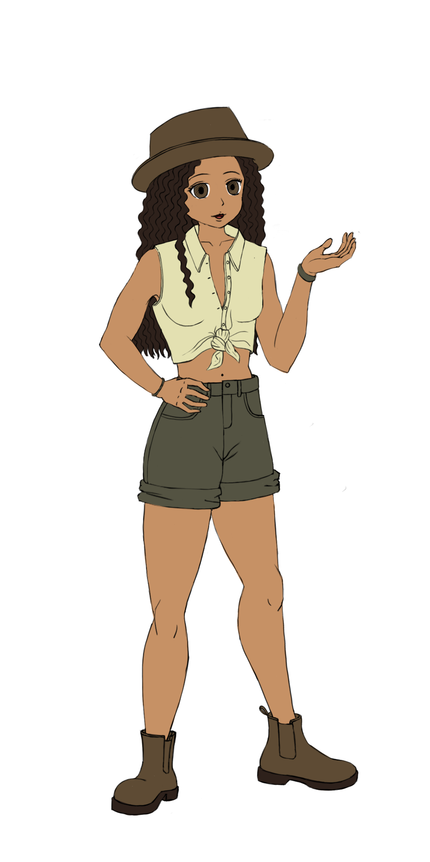
Sam travels to Australia

Slide 7
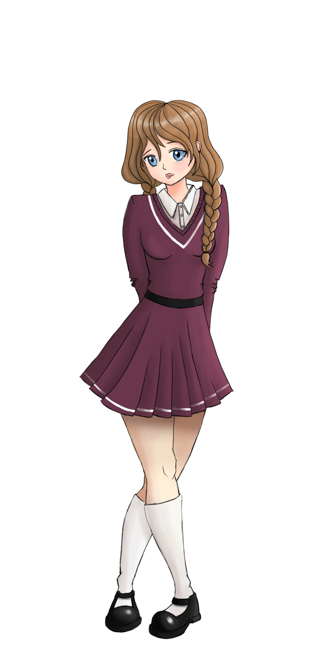
Where?
Zoo in Sydney

Slide 8
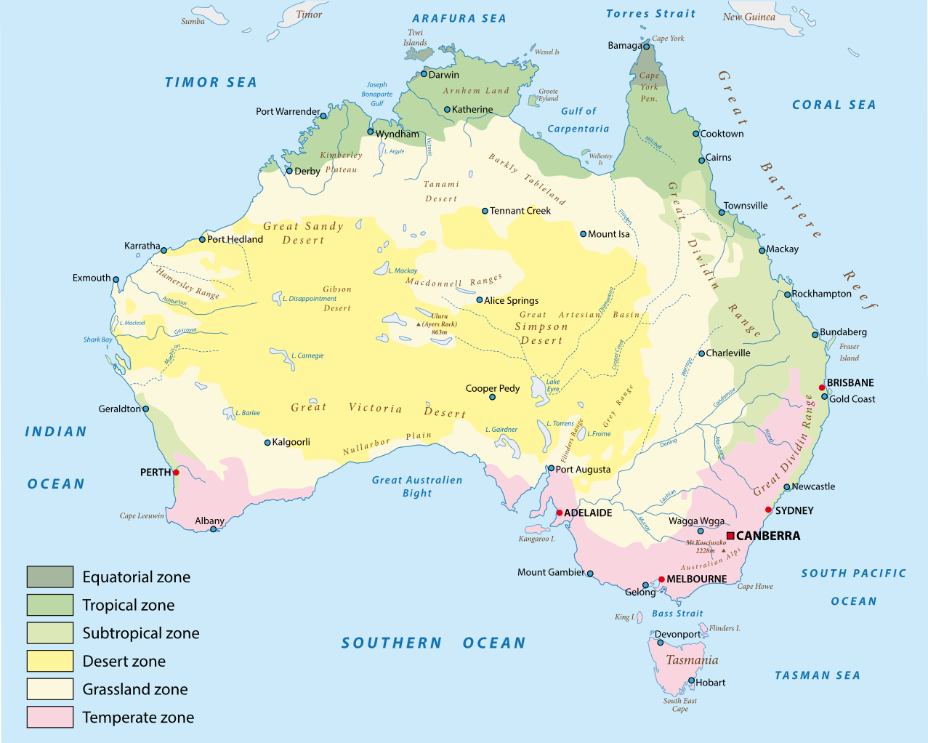
Let’s go to Sydney!

Slide 9
How?
by plane
by boat
by train
on foot
by car
by bus
by bicycle

Slide 10
How ?
Canberra
Sydney
287 km
50 mn
3h30
4h
5h15
by plane
by car
by bus
by train

Slide 11
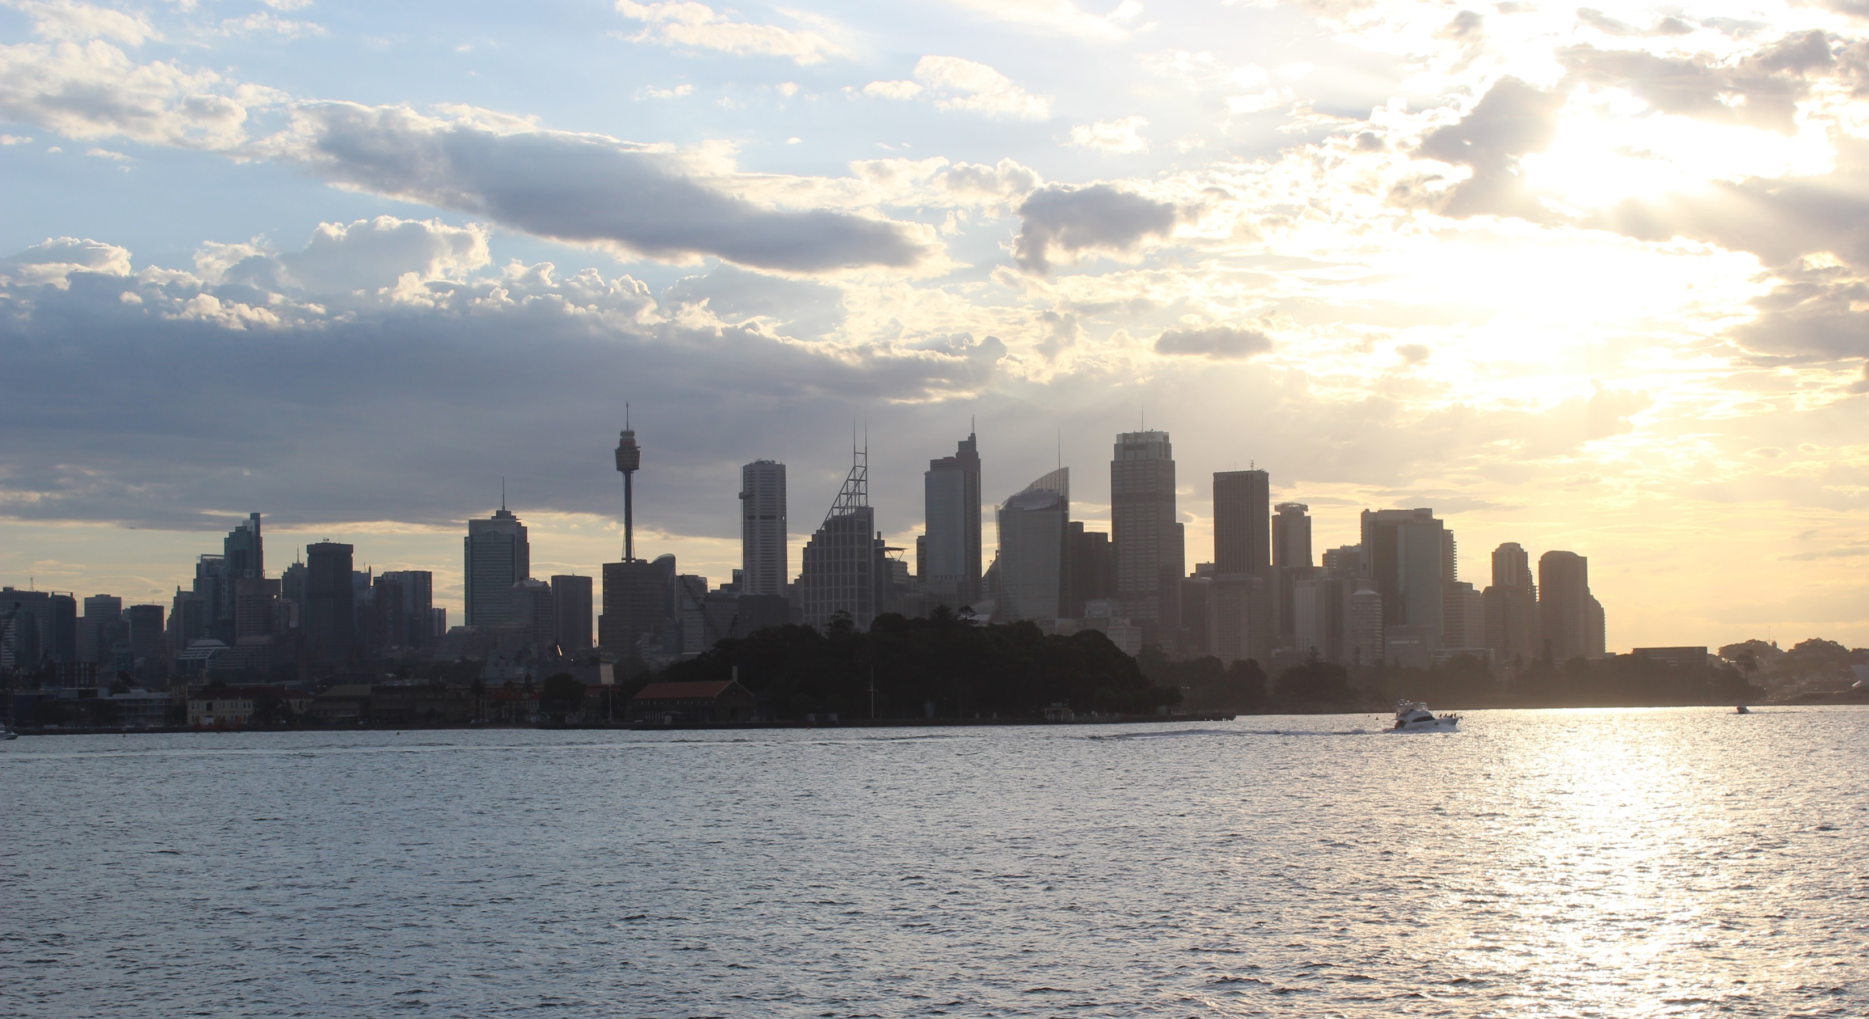
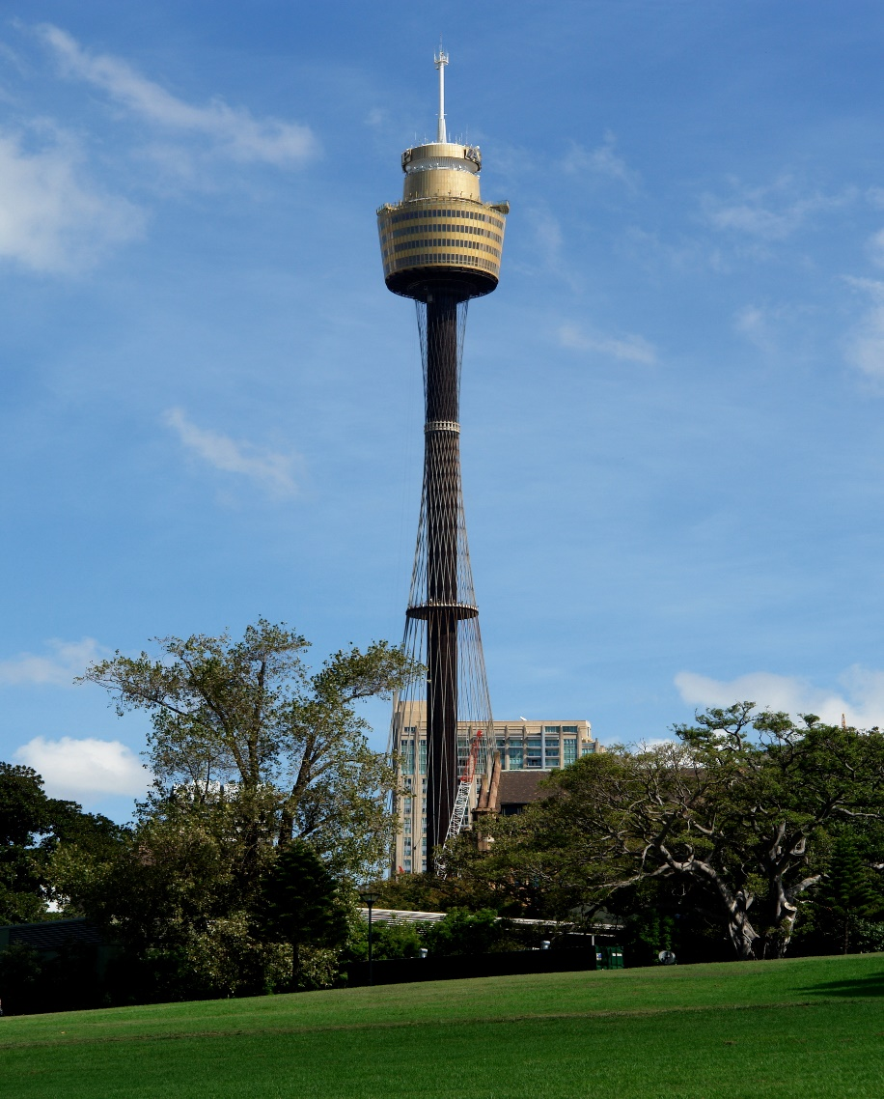
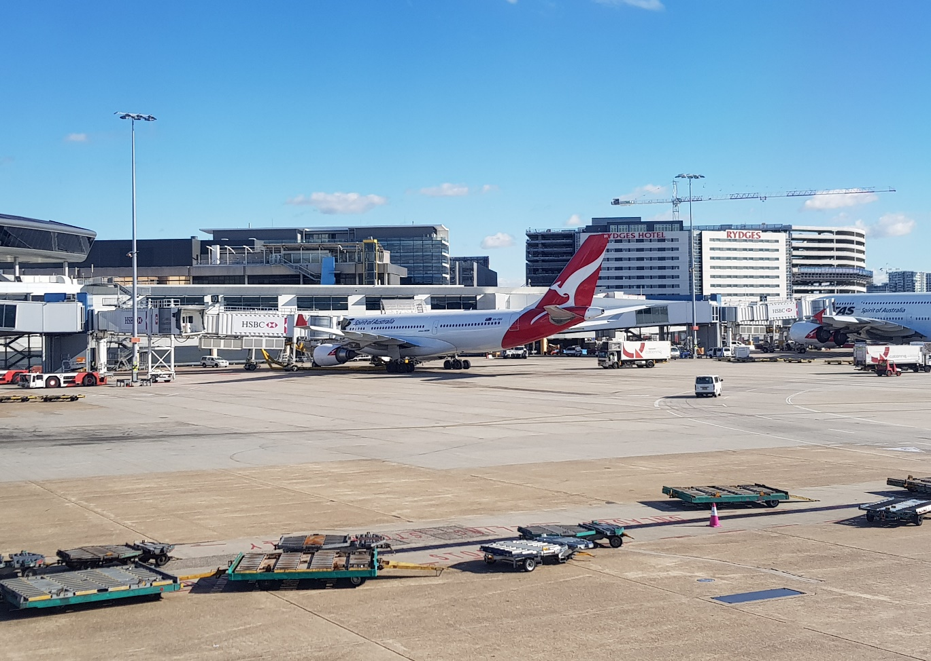
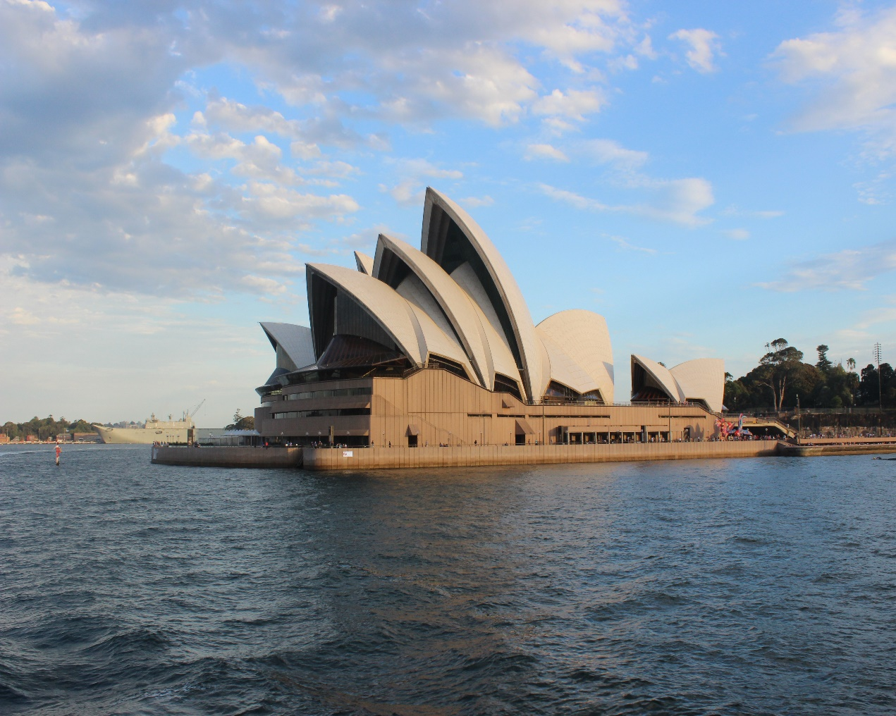
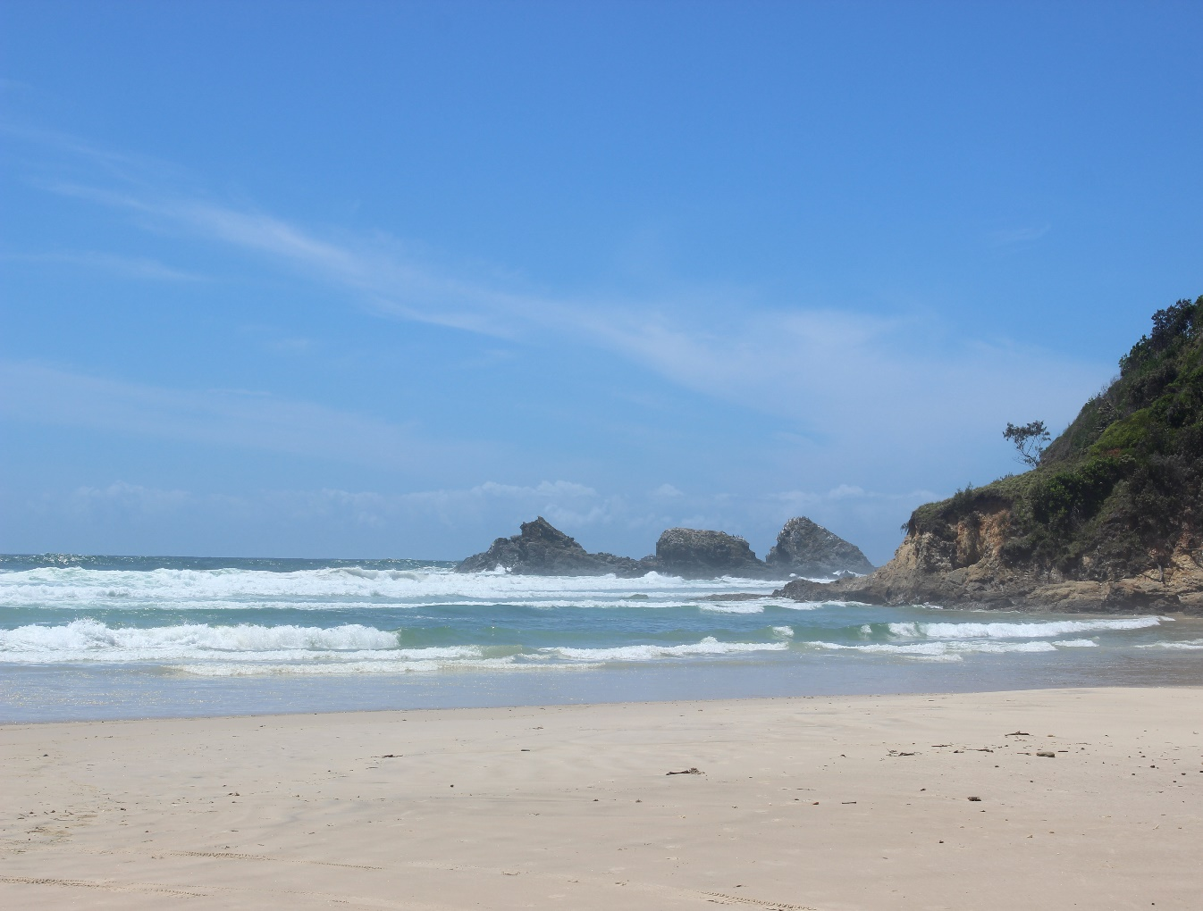
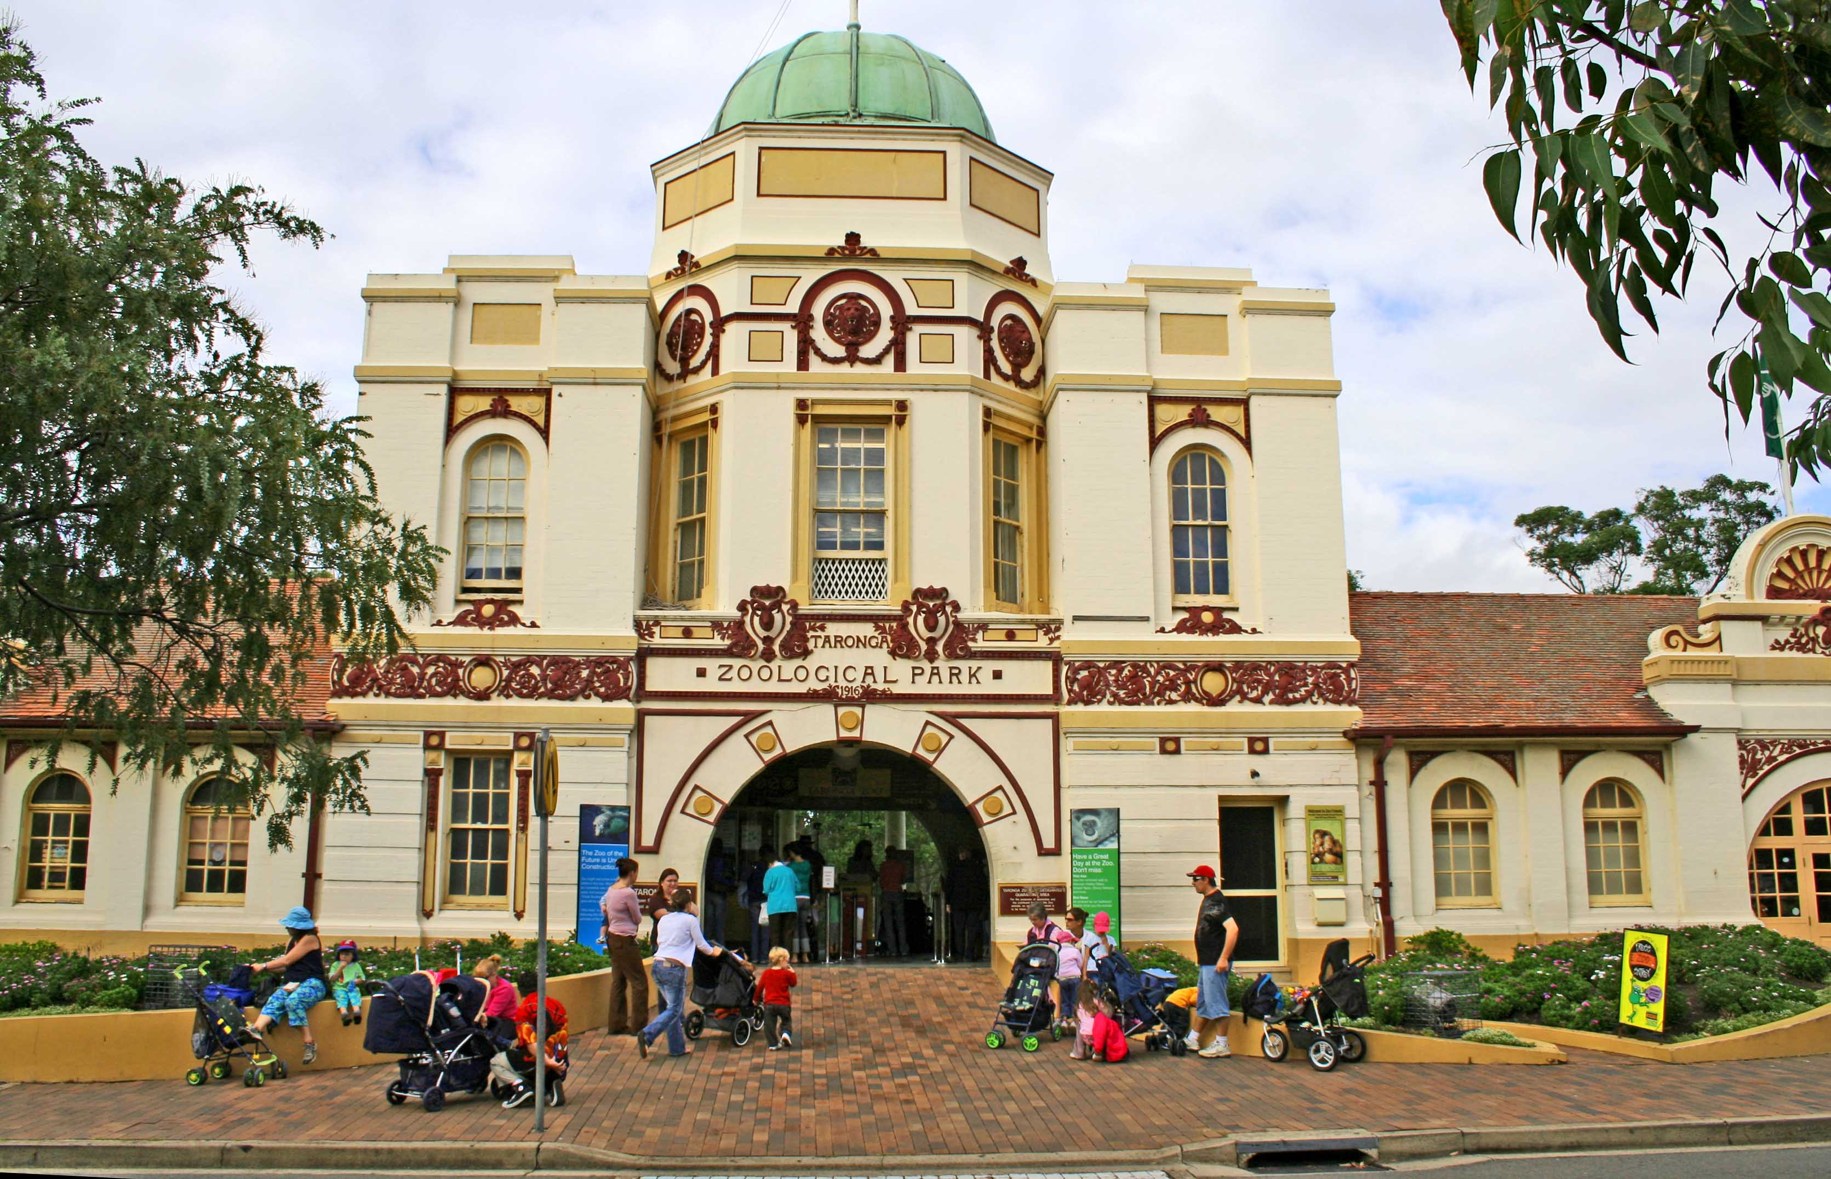
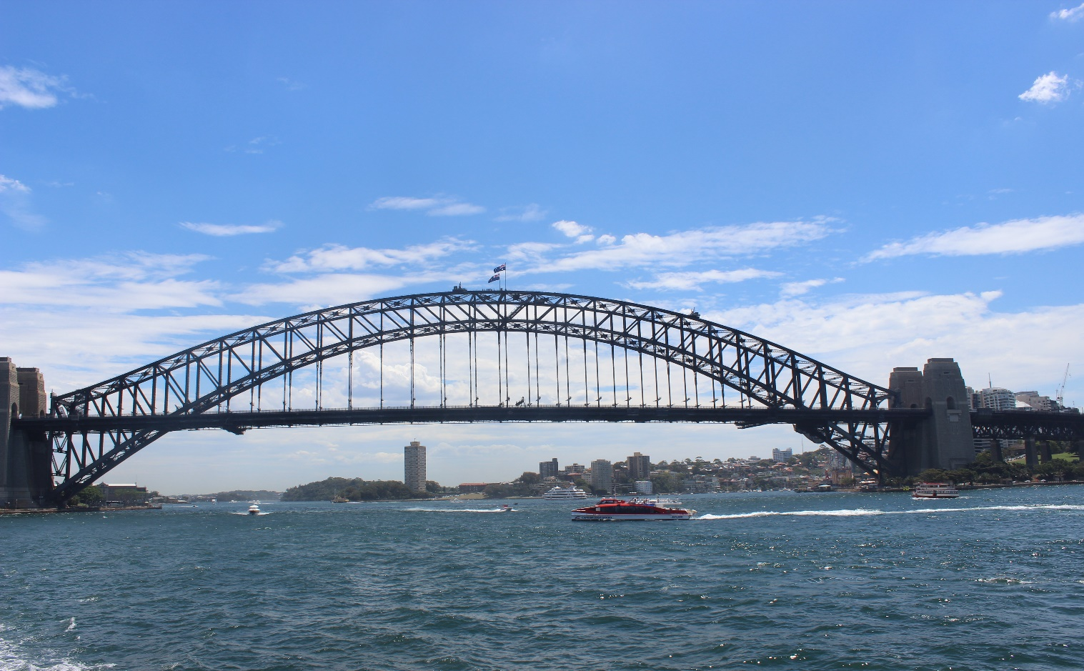
Sydney
4th
1st
then
3rd
finally
2nd
by plane
by ferry
by taxi
on foot
by bus
by cable car

Slide 12
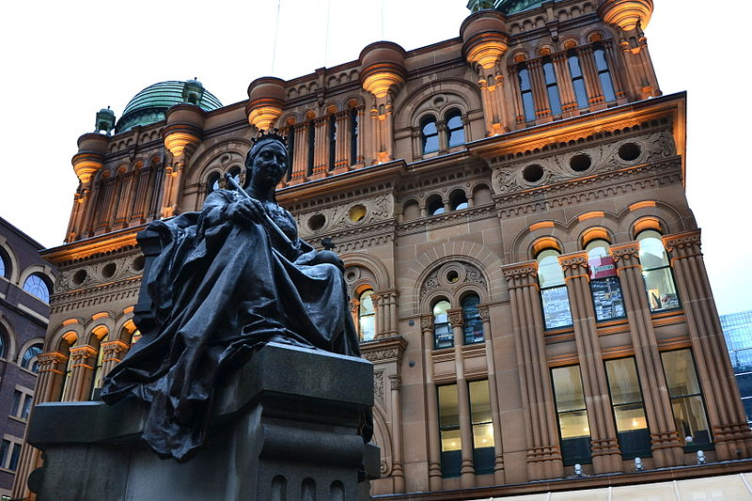
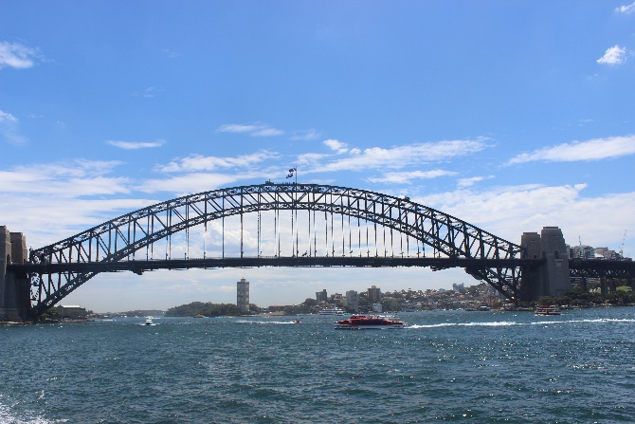
Challenge!
C
A
B
D
E
G
F
1st
2nd
3rd
4th
then
finally

Slide 13
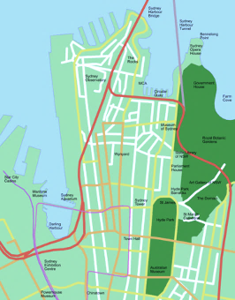
North
1st
2nd
3rd
1st
arrival

Slide 14
Let’s recap!
go straight on
turn right
turn left
turn around
cross
walk ….

Slide 15
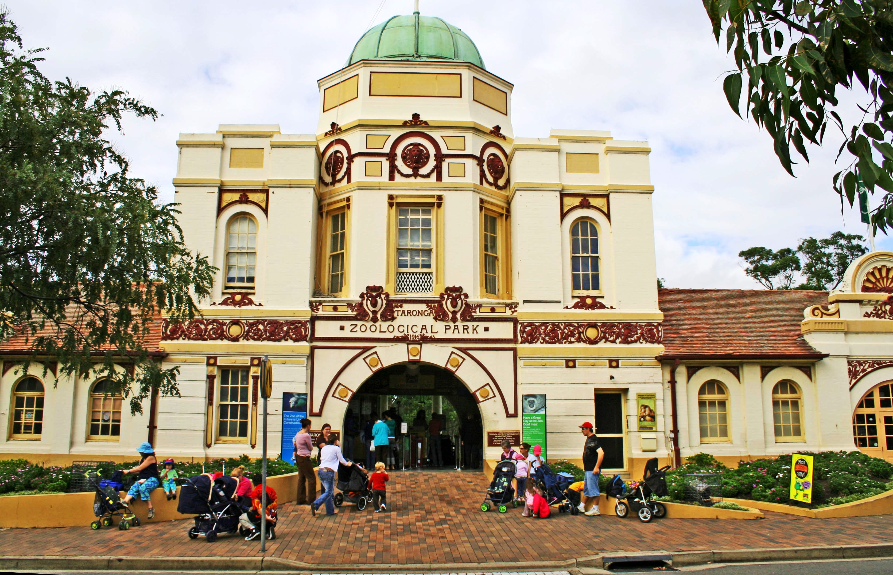
directions

Slide 16
At the zoo…
Zoo entry

Slide 17
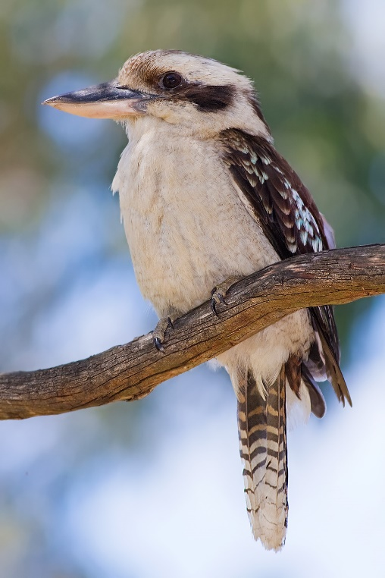
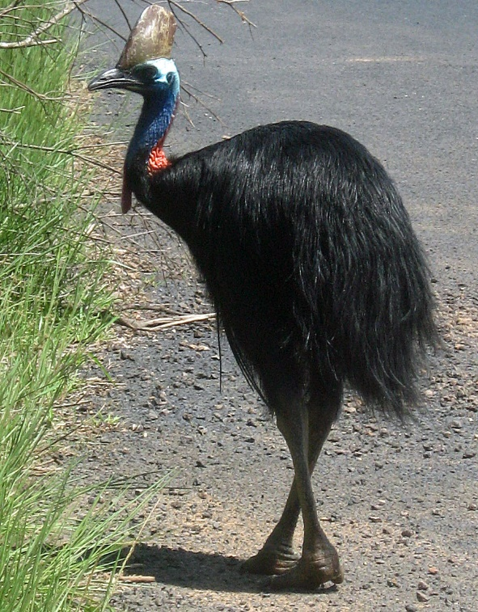
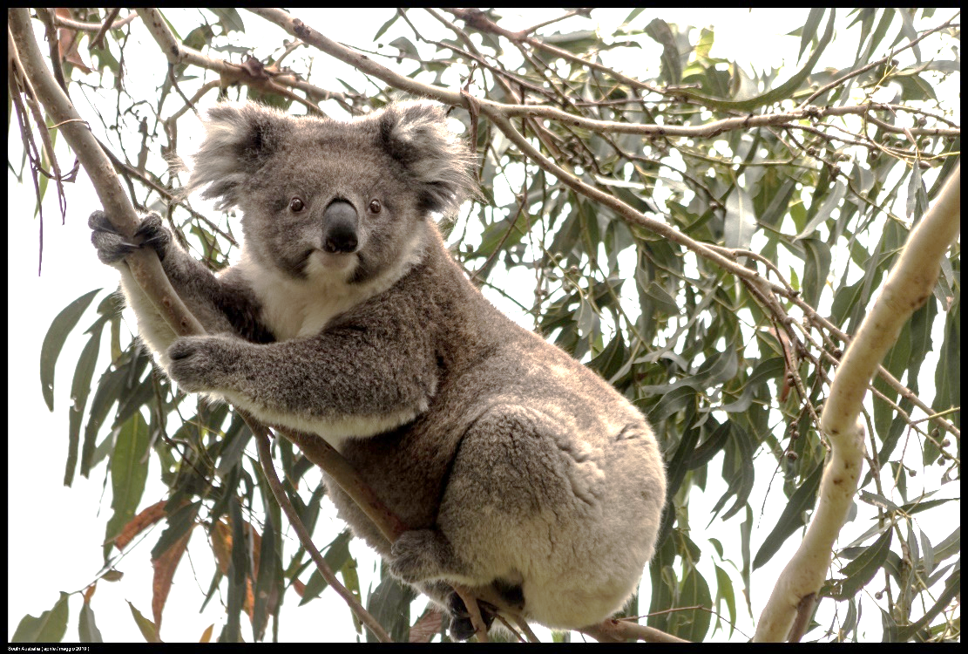
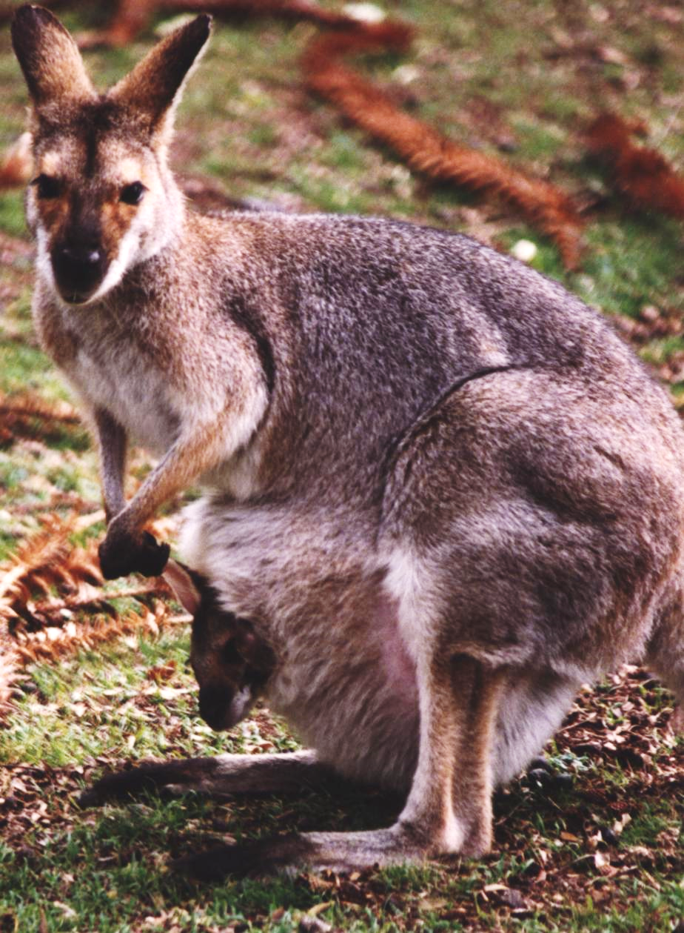
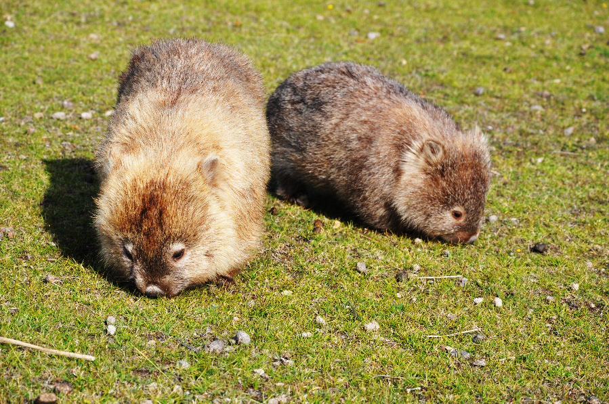
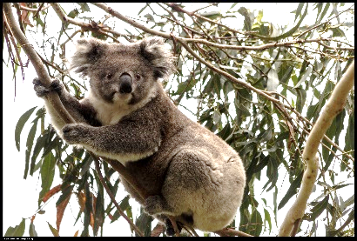
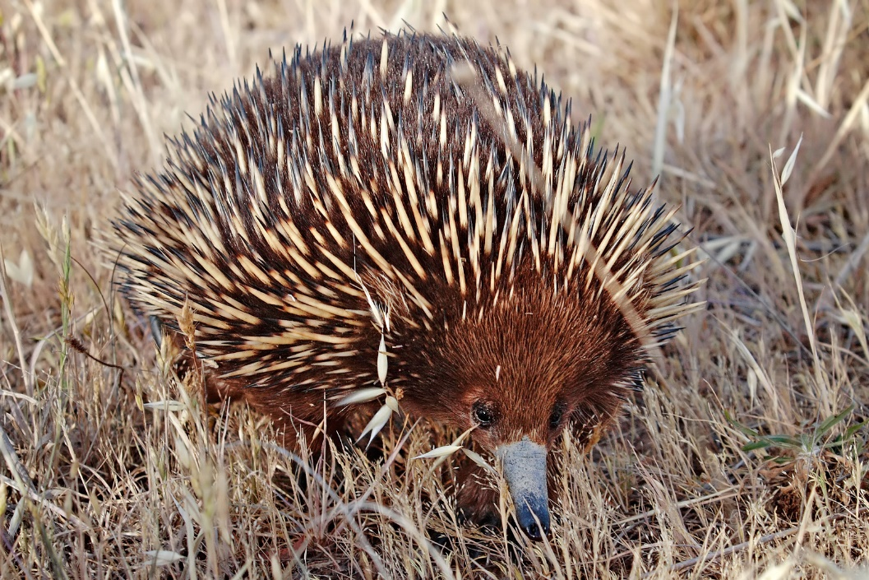
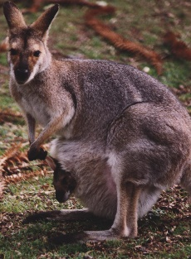
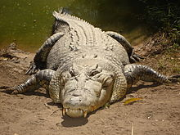
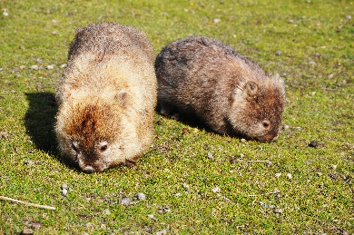
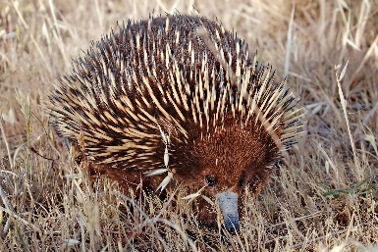
Remember!

Slide 18
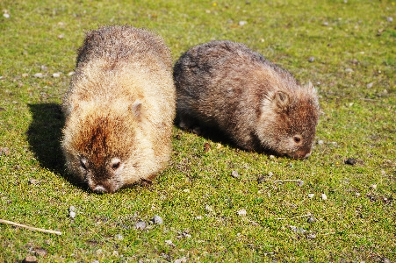
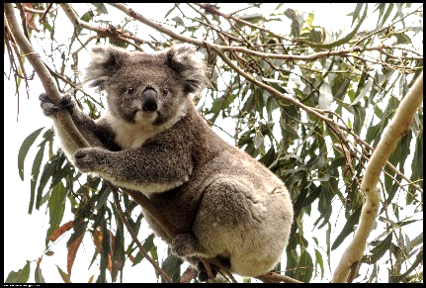
Challenge: let’s match!
1
2
3
4
koala
kangaroo
dingo
echidna
wombat
crocodile
koala
cassowary
kookaburra
8
6
7
5
koala
crocodile
echidna
kangaroo

Slide 19
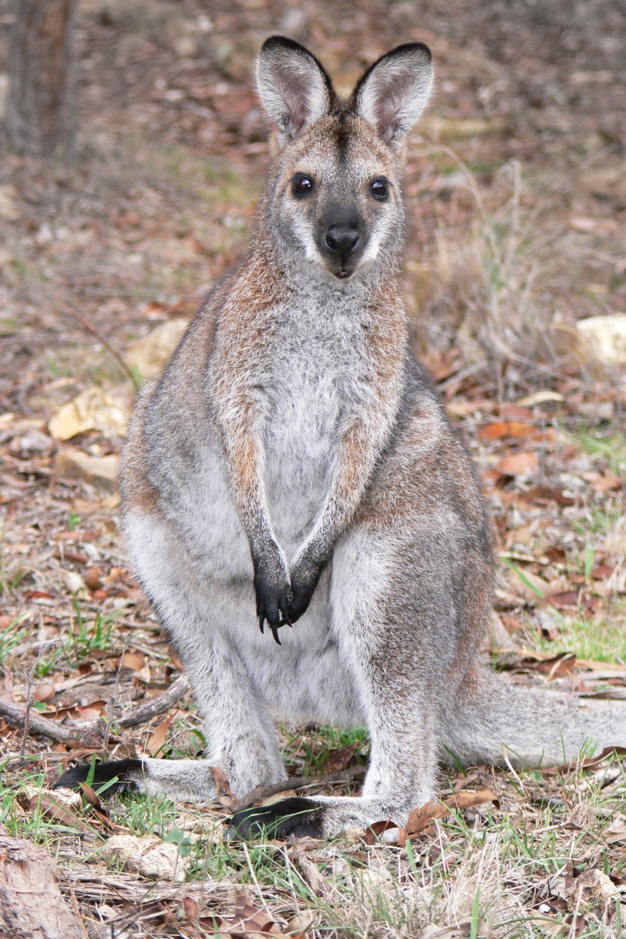
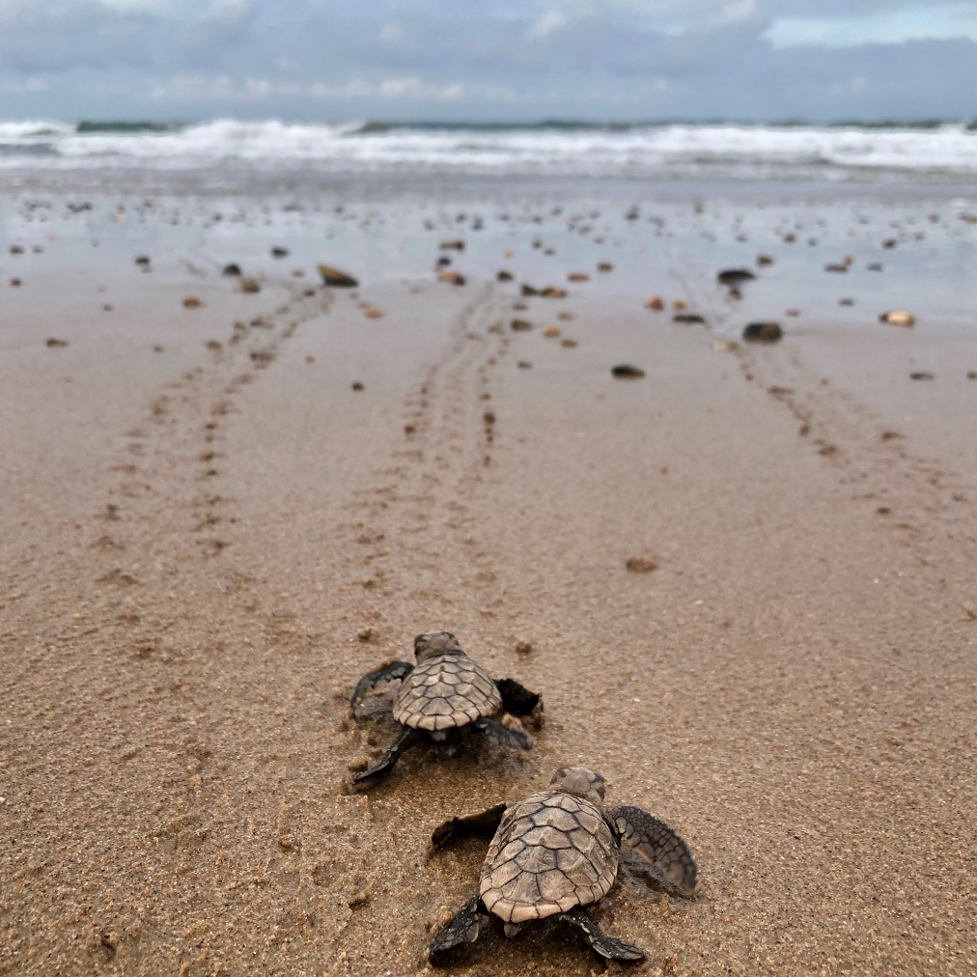
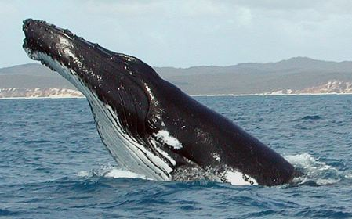
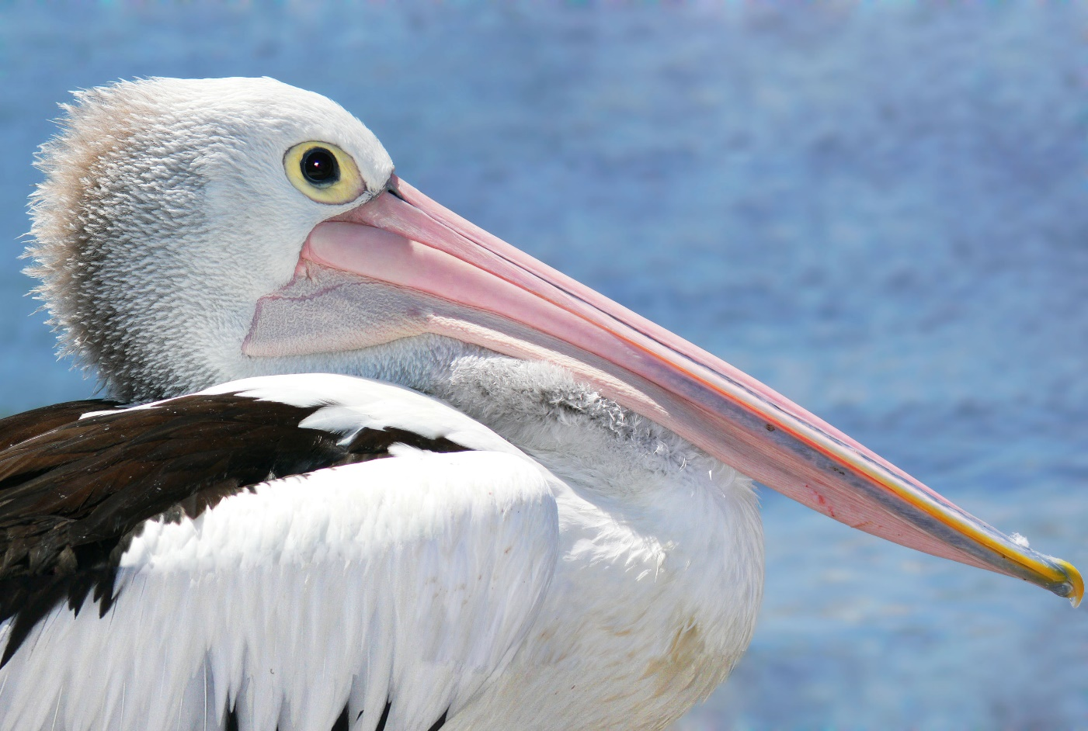
Australian animals
NEW !

Slide 20
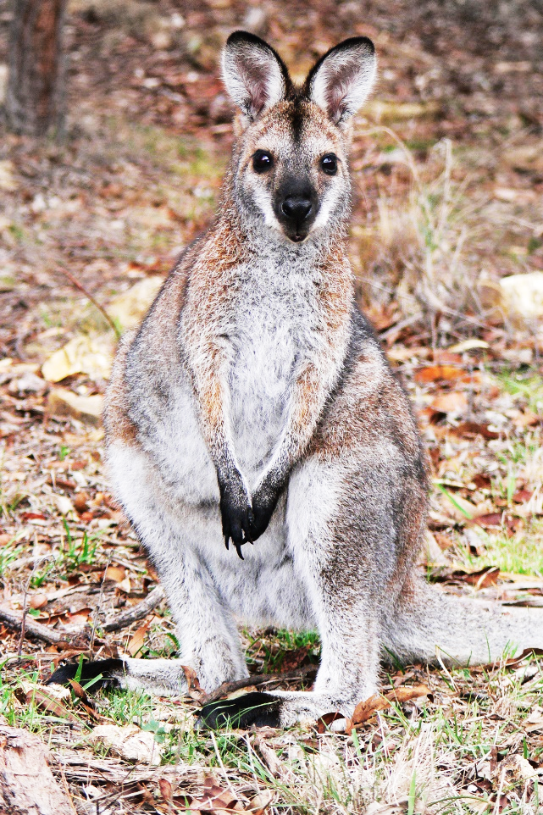
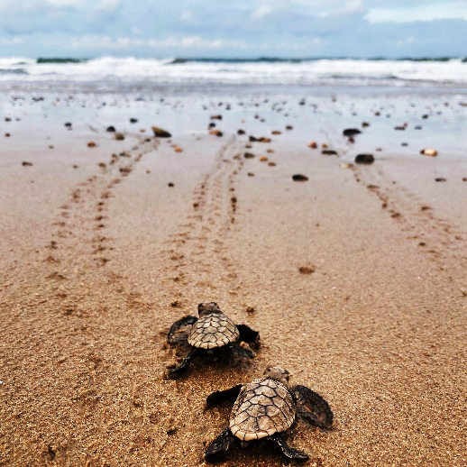
Australian animals

Slide 21
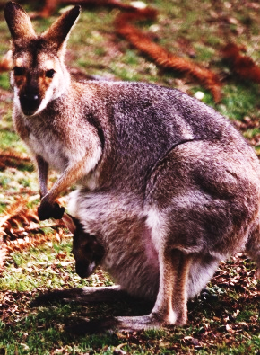
Let’s play: find who?
Who can jump ?
Who can fly ?
Who can swim ?

Slide 22
Zoo entry

Slide 23
Animals in danger!

Slide 24
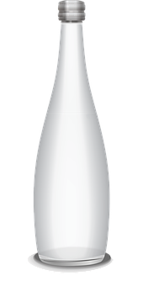
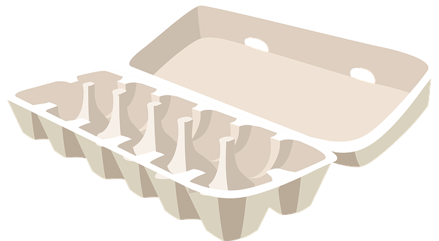
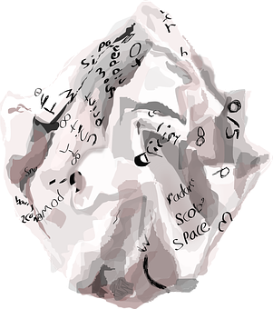
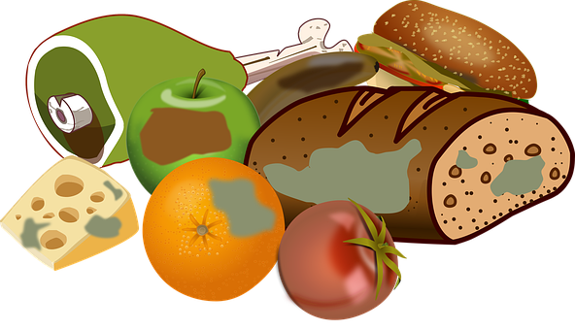
Bin it!

Slide 25
Sort it!
paper
cans
glass
plastic
food

Slide 26
Let’s recap!
Bin it!
Put litter in the bin
Recycle
Put litter
in the right bin
Sort it!

Slide 28
Memorise
Have a shower
Have a bath
Reuse
Buy new
Switch the light off
Switch the light on

Slide 29
Let’s play!

Slide 30
Let’s write a slogan!
Pick
Pick
reuse
stop
save
recycle
!
+
sort
reduce
bin
buy
take
Recycle plastic!

Slide 31
Be creative!
Don’t trash our oceans!

Slide 32
Challenge!
Create your own poster
Post it with help of an adult on:
#Englishlumni

Slide 33
Today’s lesson
Se déplacer avec un plan
Découvrir des animaux d’Australie
Trier les déchets
Protéger la planète
Ecrire un slogan

Slide 34
Goodbye song

Slide 35
CM2 - Year 6
Goodbye
by Anne-Valérie and Anna

Slide 36
Ressources and contributions
Pictures
https://stock.adobe.com/ https://pixabay.com/fr/
https://www.flaticon.com/ https://www.clipart.com/fr/index
Personal photos
Characters
Sam Lumni and her friends drawn by Manon
Audio recordings
Voices : Tess, Mansi, Lukas, Immanuel, Emily, Eddie, Sydny, Jacklyn, Richard, Dain, Erin
Music, melody and lyrics by Stephane and François
Conception
Anna, Anne-Valérie, Mathilde, Sabrina et Sandrine

