Slide 1
CM2 - Year 6
English
Class

Slide 2
Hello song

Slide 3
CM2 - Year 6
English
Class
by Anne-Valérie and Anna

Slide 4
Today’s lesson
Réviser les jours de la semaine
Associer les mois et les saisons
Écouter des anglophones
Utiliser un emploi du temps
Exprimer une préférence
Apprendre à dire l’heure
Notes:
2: Présentation des objectifs
Les enseignants présentent en français les objectifs du jour:
Enseignant 1: en français
Enseignant 2: en anglais

Slide 5
You need…
a copybook
a pencil
a whiteboard marker
a whiteboard

Slide 6
Remember: good…
morning
noon
afternoon
evening
night
Notes:
Révision à partir des good morning etc…. Pour pouvoir être réinvesti plus loin dans la leçon de lecture de l’heure

Slide 7
Remember: days of the week!
Tuesday
Monday
Tuesday
Wednesday
Monday
Wednesday
Friday
Thursday
Friday
Thursday
Saturday
Sunday
Saturday
Sunday
Notes:
Ce sont des révisions au niveau CM2. Ils les ont vus régulièrement voire tous les jours s’ils écrivaient la date ou avaient une activité ritualisée date.
Insister sur le DAY en scandant avec un tapement de main

Slide 8
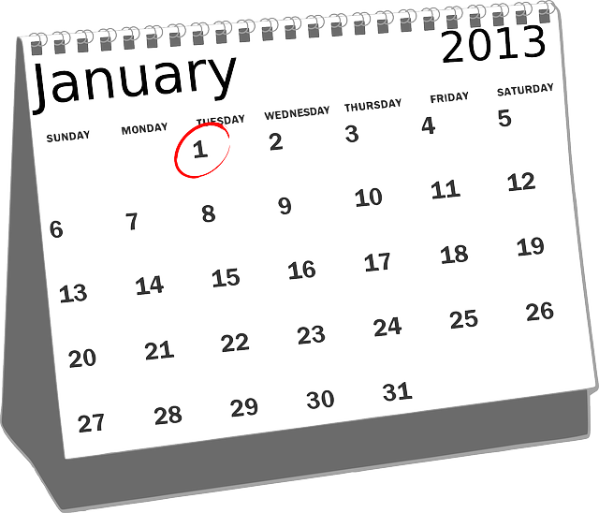
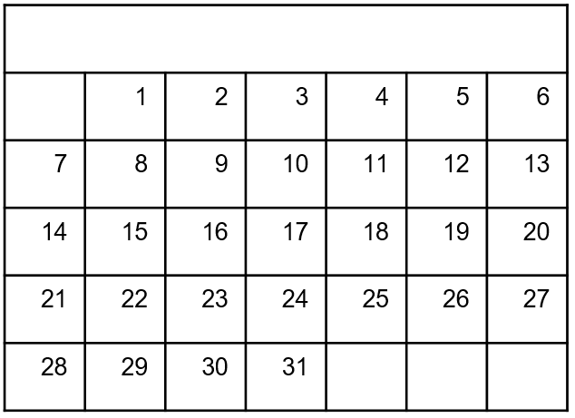
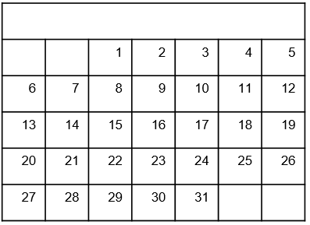
Challenge!
Janvier
January
Monday Tuesday Wednesday Thursday Friday Saturday
Monday Tuesday Wednesday Thursday Friday Saturday
Mardi Mercredi Jeudi Vendredi Samedi Dimanche
Sunday
Sunday
Lundi
Notes:
Can you spot the difference?
Différence entre calendrier français du lundi au dimanche et calendrier anglophone du dimanche au samedi

Slide 9
Remember: months and seasons
winter
spring
summer
autumn
January
April
July
October
February
May
August
November
Let’s mime !
March
June
September
December

Slide 10
Remember: like it or not?
like
love
dont’ like
hate
prefer
Notes:
On utilise don’t like (et non pas dislike) plus utile dans une expression orale

Slide 11
Sam at school
Notes:
Audio 1:
Hello, I am Sam, I’m 11.
I go to Manchester Primary school.
I’m in year 6 and I like to go to school.
Audio 2:
I like english, music and history.
I don’t like sciences and geography.

Slide 12
Sam’s timetable
Notes:
Objectif: jour de la semaine et matières: introduction ON + jour
This is Sam’s timetable.
Oh look: she goes to school 5 days a week!
On Monday… reprendre la suite des jours de la semaine
Can you find what Sam likes… english/music/history
Can you find what sam doesn’t like… science and geography
On what day Sam has english?
She has english on Monday, Thursday and Friday.
On what day Sam has Geography?
She has …

Slide 13
school subjects
Notes:
Travail de répétition / mémorisation avec jeu entre les 2 enseignantes

Slide 14
Let’s play!
4
7
1
10
5
8
2
6
11
3
9
Notes:
2 manières de jouer :
What number is …
What is number 6…

Slide 15
1
Challenge!
2
3
4
5
6
7
8
9
10
Notes:
Ajouter audio timer 10 sec
Revoir l’animation du timer
Refaire audio 3 Sam
« Can you name 5 school subjects in english ?»

Slide 16
1
Challenge!
2
3
4
5
Notes:
What’s missing?

Slide 17
1
Challenge!
2
3
4
5
Notes:
What’s missing?

Slide 18
1
Challenge!
2
3
4
5
Notes:
What’s missing?

Slide 19
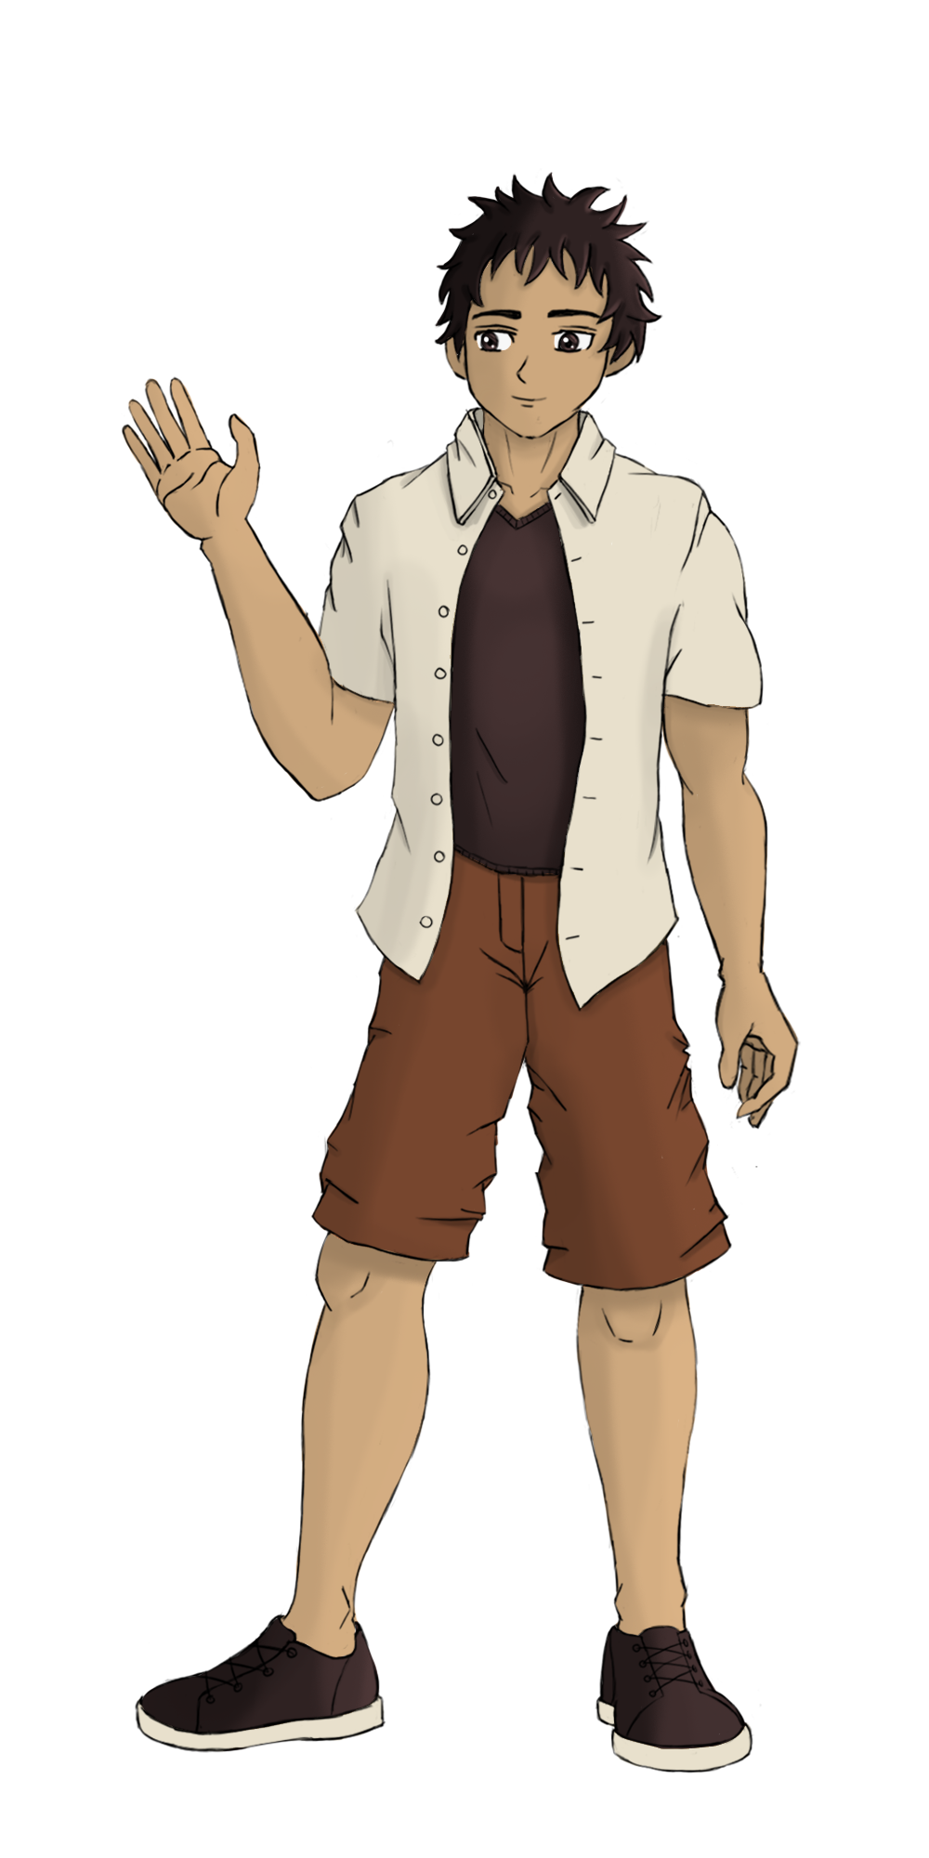
Immanuel at school

Slide 20
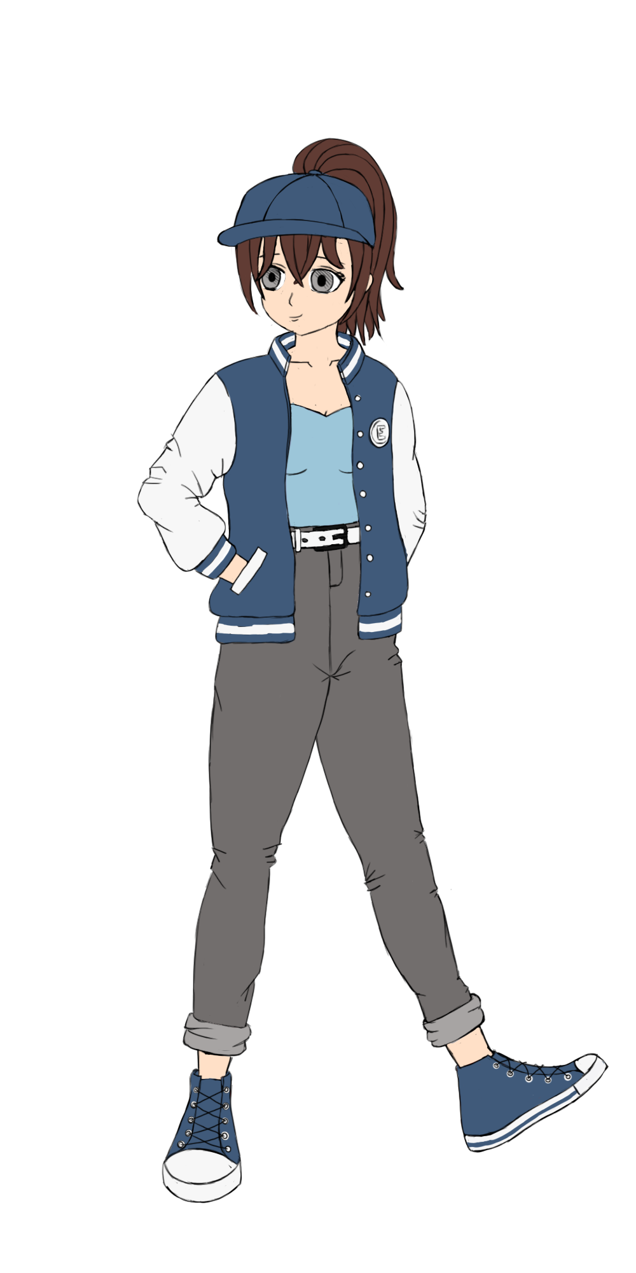
Emma at school
Notes:
Emma:
#1:
Hello, my name is Emma.
I am 15 and I live in California.
I go to school in San Fransisco.
Enseignante interpelle Emma: Hi Emma, can you tell us about your favourite subjects at school?
Sam likes english, music and history. She doesn’t like science and geography.
What about you?
#2:
I like drama and art, it’s a lot of fun.
I don’t like maths and PE. It’s too difficult.
I prefer English.

Slide 21
What about you?
Notes:
Emma:
#1:
Hello, my name is Emma.
I am 15 and I live in California.
I go to school in San Fransisco.
Enseignante interpelle Emma: Hi Emma, can you tell us about your favourite subjects at school?
Sam likes english, music and history. She doesn’t like science and geography.
What about you?
#2:
I like drama and art, it’s a lot of fun.
I don’t like maths and PE. It’s too difficult.
I prefer English.

Slide 22
Notes:
Introduire before et after
Utilisation à tour de rôle de l’emploi du temps pour le compléter, avec introduction de morning et afternoon
Sam has science on Wednesday morning period 1
Period 4 is math
She has art at 10
After the break she has ICT
She has drama in the afternoon after lunch
Ecoute de l’enregistrement 4 puis 5
Sam has PE on Monday but in the morning or in the afternoon ?
We need to learn how to tell what time i is

Slide 23
What time is it?
It’s 8 o’clock.

Slide 24
What time is it?
It’s 10 o’clock.

Slide 25
What time is it?
It’s 3 o’clock.

Slide 26
What time is it?
It’s midday.
It’s noon.
It’s midnight.
It’s 12 o’clock.

Slide 27
Your turn!
A
B
C
Notes:
Ecouter 3 horaires et dire si c’est A-B-C

Slide 28
Your turn!
Notes:
Ecouter et dessiner l’heure.
2 o’clock
11 o’clock
midnight

Slide 29
What time is it?
It’s half past 8.

Slide 30
What time is it?
A
B
It’s half past 9
C
D
It’s 5 o’clock
Notes:
Choose the right clock

Slide 31
What time is it?
to
past
Notes:
Dessiner les aiguilles
Insister sur to=before

Slide 32
What time is it?
quarter
quarter
to
past
Notes:
Dessiner les aiguilles
Insister sur to=before

Slide 33
What time is it?
A
B
It’s quarter past 11
C
D
It’s quarter to 4
Notes:
Choose the right clock

Slide 34
Your turn!
Notes:
Ecouter et dessiner l’heure.
2 o’clock
11 o’clock
midnight

Slide 35
Tic Tac Toe!
7:30
9:00
4:15
7:00
10:00

Slide 36
Notes:
Poser des questions Enseignantes 1 et 2
Associer day/ time/ subject
Interaction avec les élèves

Slide 37
Sentence building
and
I
and
I
like
like
hate
I
hate
I
love
but
I
I
love
but
I
prefer
I
don’t like
,
I
prefer
I
don’t like
,

Slide 38
Challenge! Your timetable
?
Notes:
Create your timetable.
Tell us what you like, what do don’t like and what you prefer like Emma and Immanuel.

Slide 39
Challenge!
?
Post it with help of an adult on:
#Englishlumni

Slide 40
Today’s lesson
Réviser les jours de la semaine
Associer les mois et les saisons
Écouter des anglophones
Utiliser un emploi du temps
Exprimer une préférence
Apprendre à dire l’heure

Slide 41
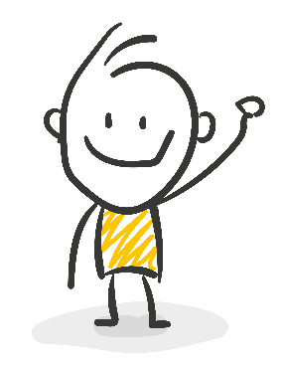
Goodbye song

Slide 42
CM2 - Year 6
Goodbye
by Anne-Valérie and Anna
Notes:
/

Slide 43
Ressources and contributions
Pictures
https://stock.adobe.com/ https://pixabay.com/fr/
https://www.flaticon.com/ https://www.clipart.com/fr/index
Personal photos
Characters
Sam Lumni and her friends drawn by Manon
Audio recordings
Voices : Tess, Mansi, Lukas, Immanuel, Emily, Eddie, Sydny, Jacklyn, Richard, Dain, Erin
Music, melody and lyrics by Stephane and François
Conception
Anna, Anne-Valérie, Mathilde, Sabrina et Sandrine

