Slide 1
KEEP CALM
AND SPEAK
ENGLISH

Slide 2
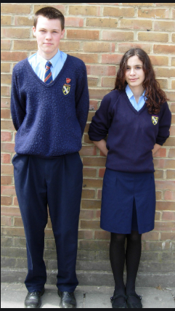
School in England

Slide 3
Dans ce cours tu vas apprendre à mieux connaître:
L’uniforme d’un collégien britannique
Les obligations et interdictions à l’école
Et tu vas t’entraîner à comprendre un texte

Slide 4
Girls’ school uniform
In my school, We must wear a green blazer with the school emblem on it. Girls must wear a white blouse and the school tie. My tie is green yellow and red. We must wear a grey skirt and grey tights. We must also wear black shoes. It’s a nice uniform, I like it!
green
white
green yellow and red
grey
grey
black

Slide 5
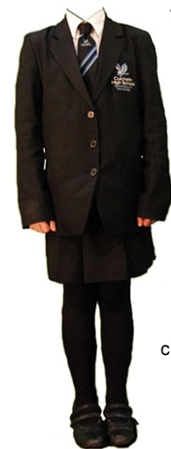
6
Tights
A blazer
A tie
A skirt
Shoes
A blouse
The school emblem
3
7
2
4
1
5

Slide 6
Girls’ school uniform
A blouse
A school blazer
The school tie
The school emblem
A skirt
tights
shoes

Slide 7
Boys’ school uniform
Boys must wear a white shirt and the school tie in my school. Mine is green red and yellow!
We must wear a green blazer : you can see the school emblem on mine. We must wear grey trousers and black socks. We must also wear black shoes. I don’t like my uniform because I hate grey and green
white
grey
black

Slide 8
1
A shirt
A tie
Trousers
The school emblem
Shoes
A blazer
2
4
6
3
5

Slide 9
Boys’ school uniform
A shirt
A school blazer
The school tie
The school emblem
trousers
socks
shoes

Slide 10
Méthodologie
Pour t’aider à comprendre un texte :
Regarde les illustrations ou le titre s’il y en a.
Sers-toi des mots que tu connais.
Si un mot ne te semble pas logique,
méfie toi c’est peut-être un faux ami!

Slide 11
The school uniform :
a choice or an obligation?

Slide 12
Girls’ school uniform
In my school, We must wear a green blazer with the school emblem on it. Girls must wear a white blouse and the school tie. My tie is green yellow and red. We must wear a grey skirt and grey tights. We must also wear black shoes but we mustn’t wear trainers. It’s a nice uniform, I like it!
must
must
must
must
Mustn’t
trainers.

Slide 13
Pour exprimer une obligation en anglais j’utilise :
MUST + un verbe
In England, they must wear a uniform!
Pour exprimer une interdiction en anglais j’utilise :
MUSTN’T + un verbe
They mustn’t wear trainers at school!

Slide 14
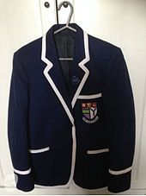
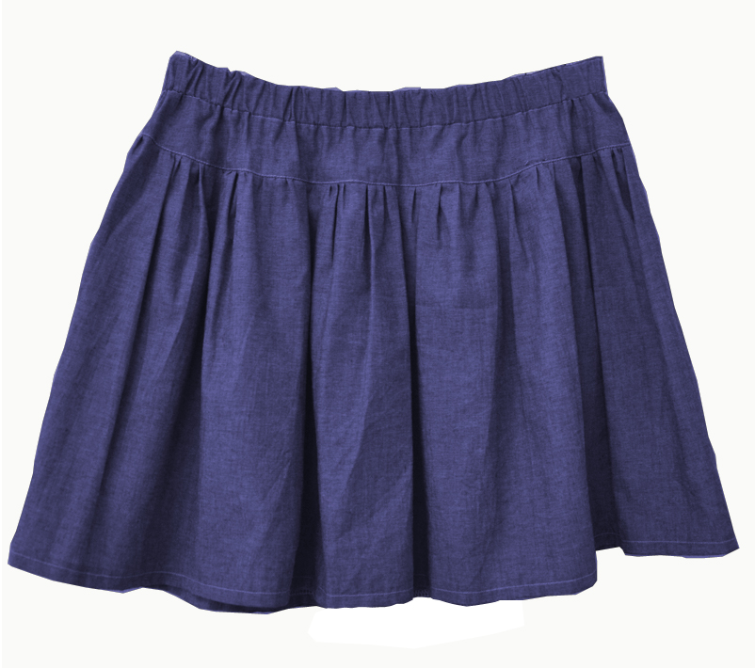
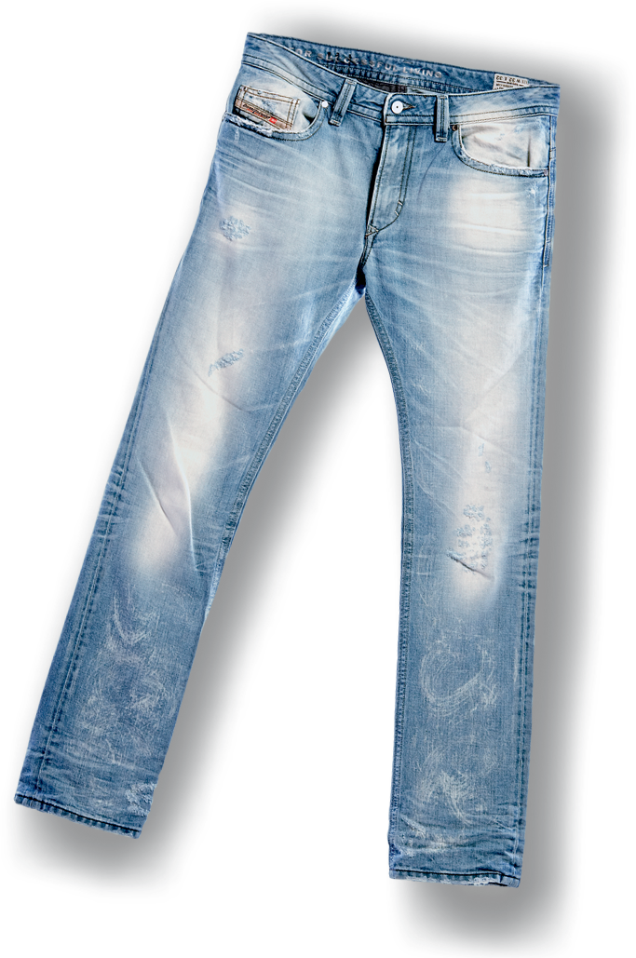
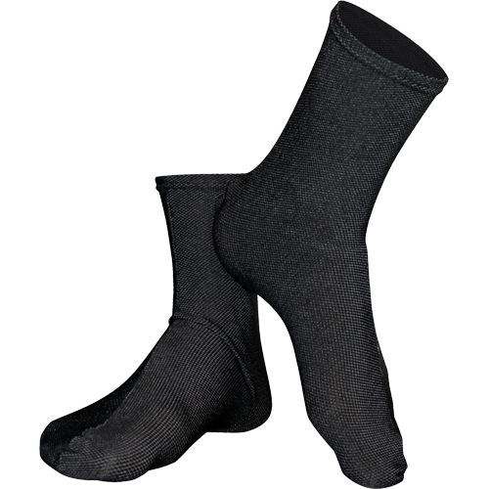
You must wear your uniform!
They must
wear a blazer.
They mustn’t
wear caps.
Girls must wear a blue skirt.
Boys must wear a white shirt and a grey tie.
They mustn’t
wear jeans.
They mustn’t
wear trainers.
They must
wear black socks.
They must
wear black shoes.

Slide 15
The library

Slide 16
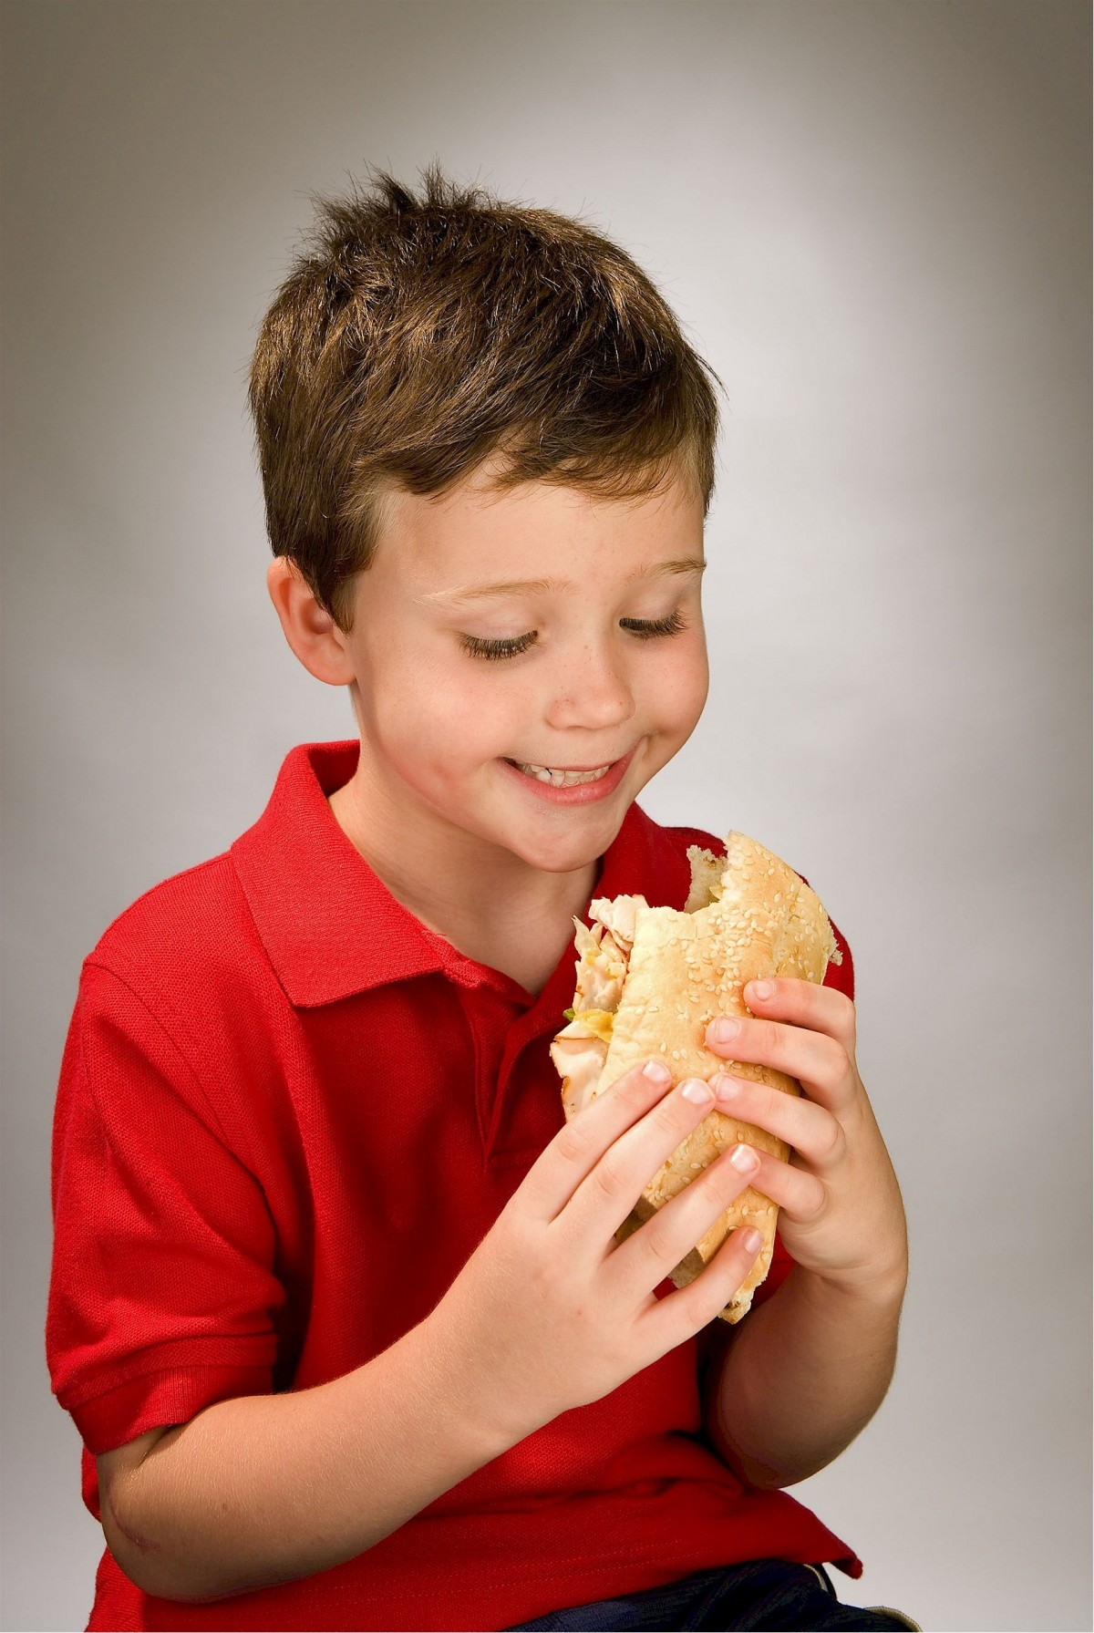
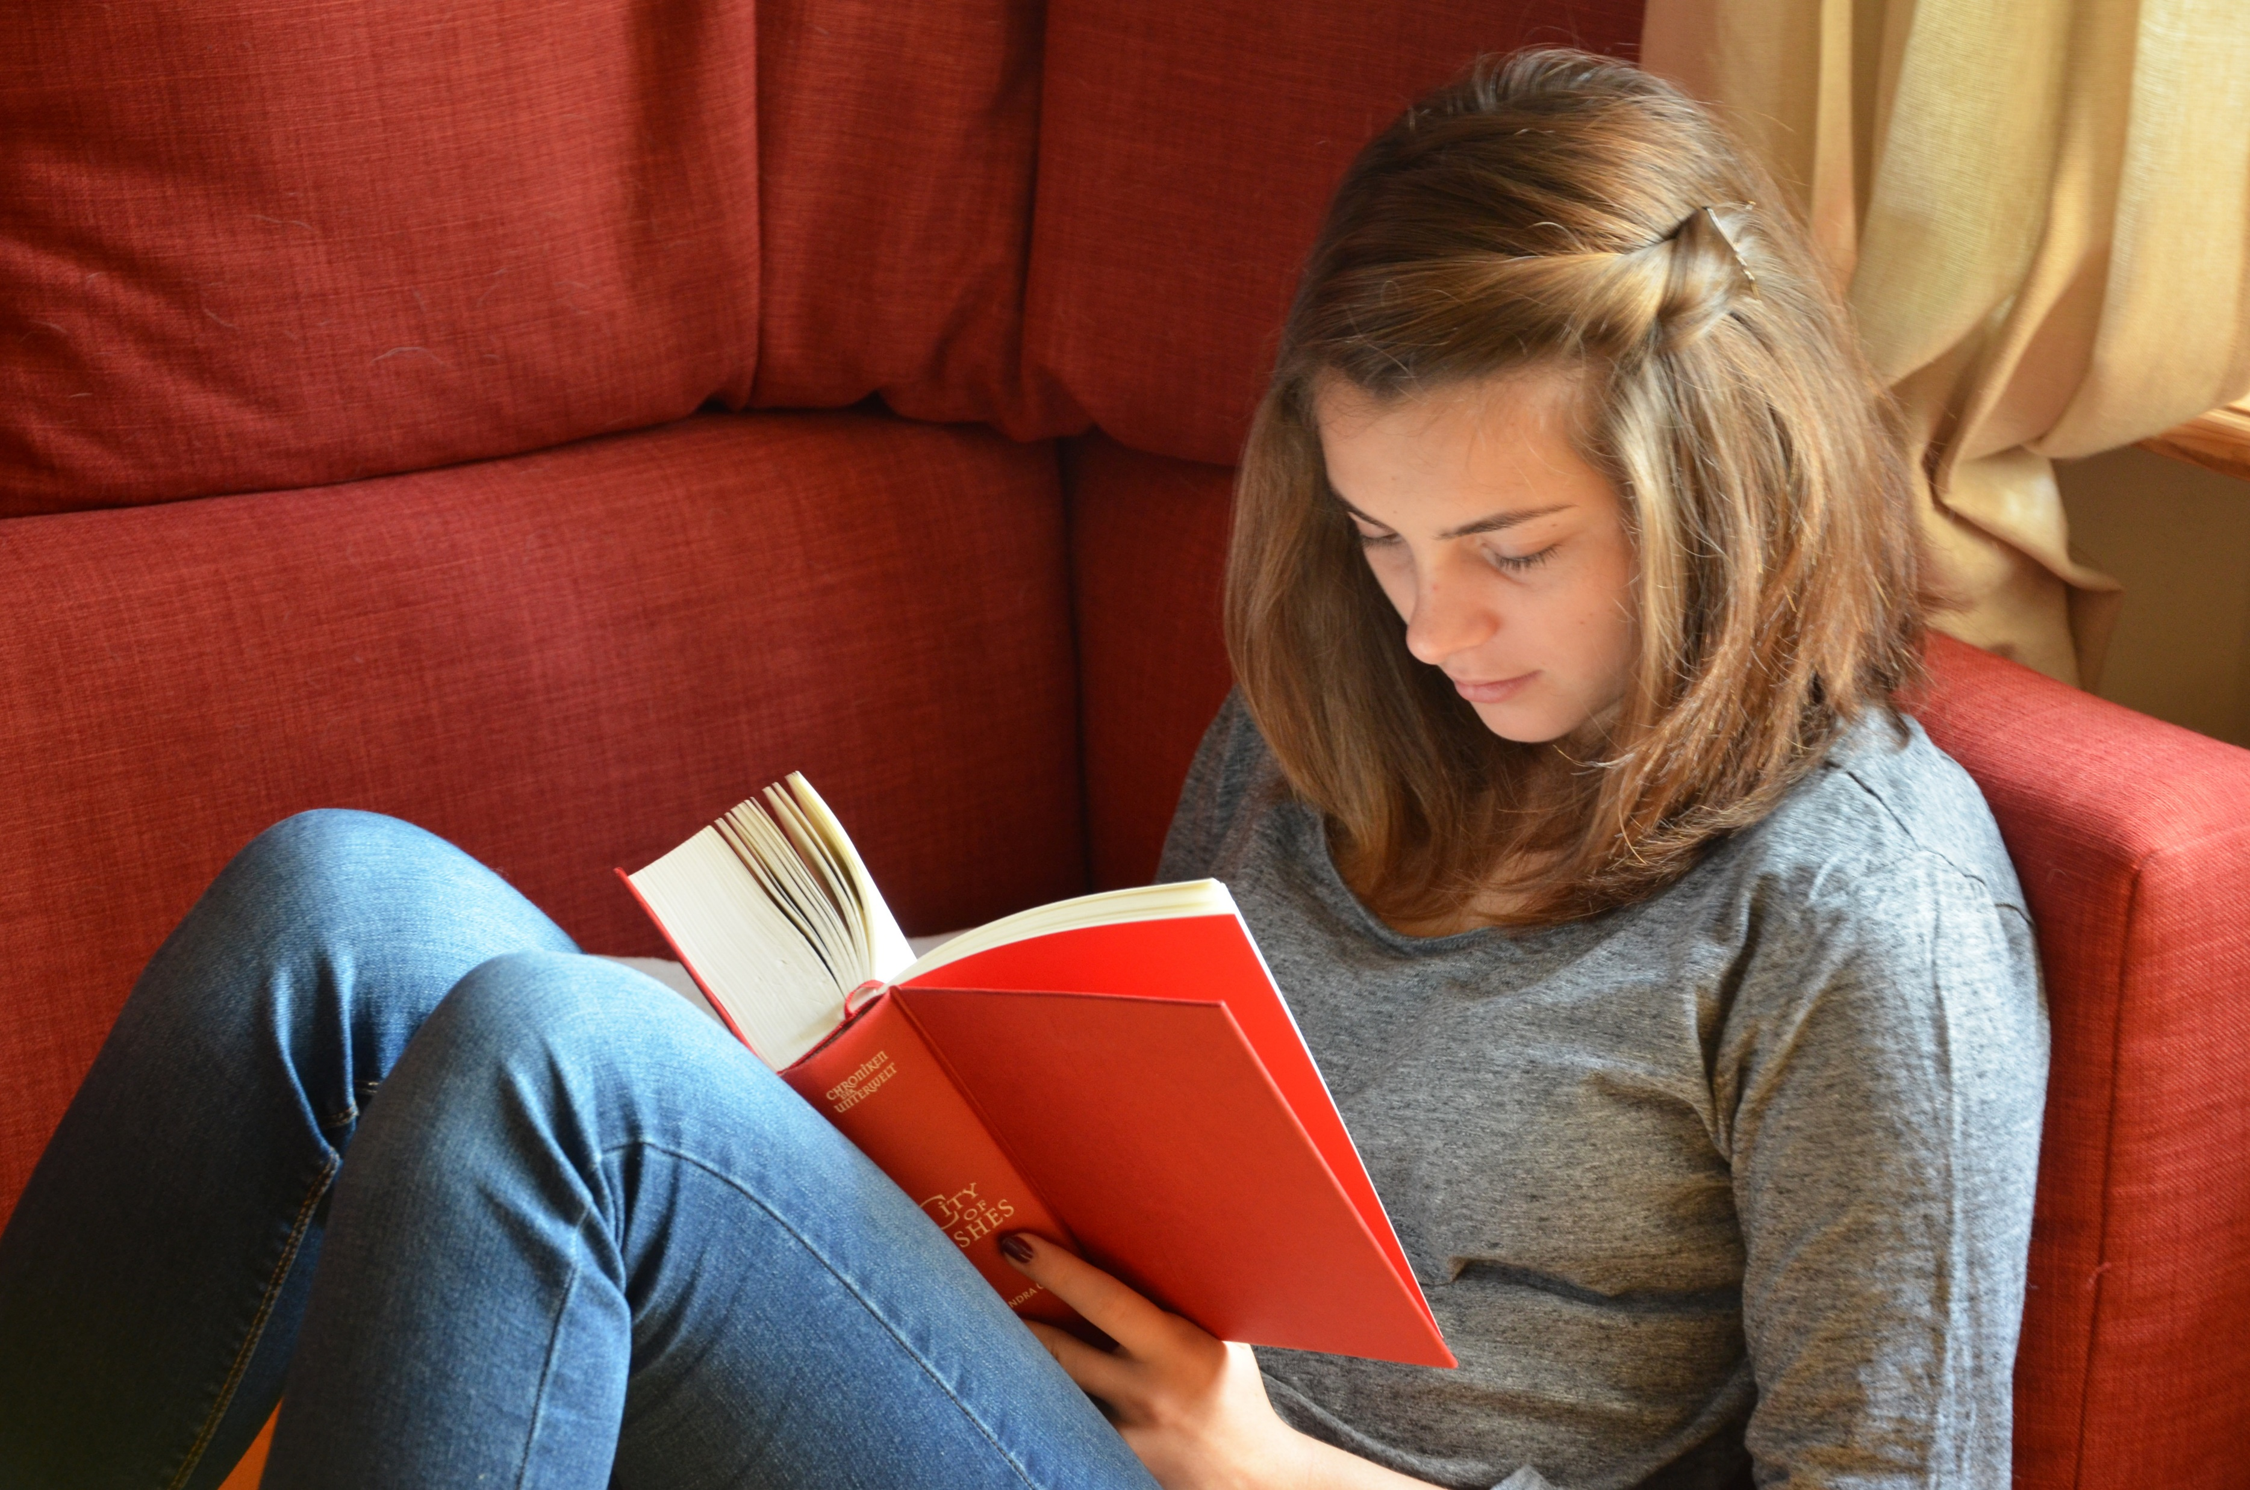
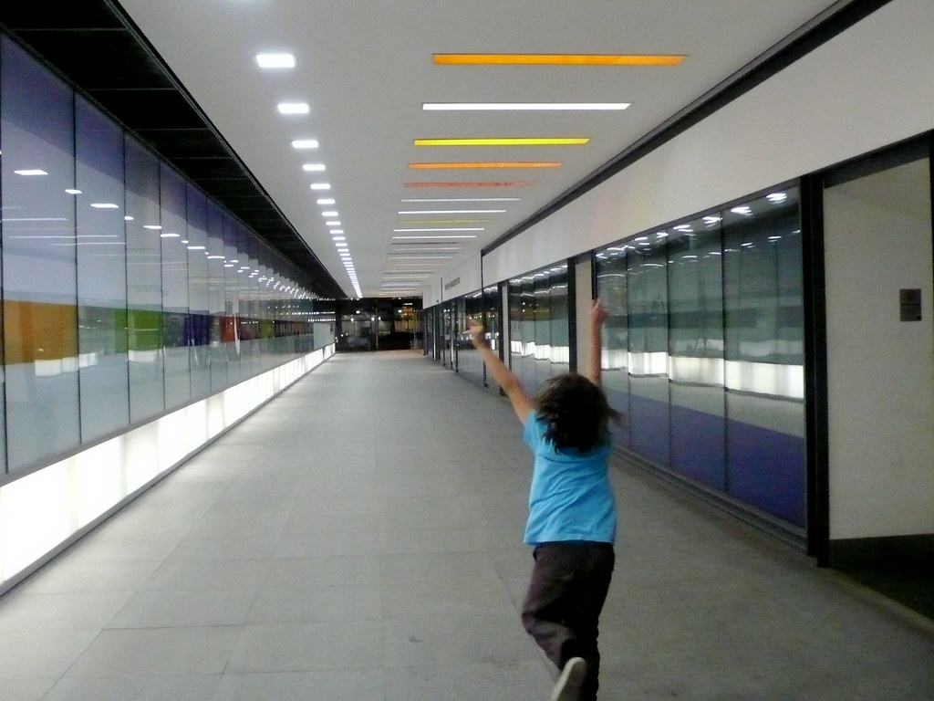
Actions in the school library
Borrow
books
read
shout
eat
Use the
computers
Be
quiet
drink
run

Slide 17
Rappel
Pour exprimer une obligation j’utilise :
MUST + une action
Pour exprimer une interdiction j’utilise :
MUSTN’T + une action
Tu viens de voir que pour exprimer une possibilité ou une permission j’utilise :
CAN + une action

Slide 18
Remarque
En mettant MUST à la forme négative tu obtiens MUSTN’T
Tu passes ainsi d’une obligation à une interdiction.
En mettant CAN à la forme négative tu obtiens CAN’T.
Tu passes ainsi d’une permission à une non permission, c’est-à-dire à une interdiction!

Slide 19
Let’s practise!
Speak about the rules in the library.
You can borrow six books.
6 books

Slide 20
You can read in the library.

Slide 21
You mustn’t / can’t run in the library.

Slide 22
You mustn’t / can’t eat or drink in the library.

Slide 23
You mustn’t / can’t use your mobile.
You mustn’t / can’t shout.
You must be quiet!.

Slide 24
Now use must, mustn’t or can in this text.
In my English class, we
must
speak English but we
mustn’t / can’t
speak French.
We
can
drink water,
But we
mustn’t / can’t
eat in class.
We
must
listen
to the teacher and we
must
respect our classmates.
We
can
ask a question if we’ve got a problem,
but we
must
raise our hands!

Slide 25
Dans ce cours tu as appris :
À parler de l’uniforme britannique
À parler d’obligations, d’interdictions et de permissions
Comment mieux comprendre un texte

Slide 26
Thank you very much, see you soon!

